Slide 1
Continual Learning for Image Classification
Course 4: Components and evaluation
Adrian Popescu
adrian.popescu@cea.fr

Slide 2
Overview
Zoom on
  Memory buffer
  New data handling
  Neural architectures
  Complexity
  Pretraining
Evaluation
  Settings
  Pitfalls

Slide 3
Memory buffer

Slide 4
Image-based buffers
Most common way to store exemplars of past classes
Simple and intuitive way to represent the past
  Provided that storage of examples is possible and/or allowed
The CL problem is basically transformed into an imbalanced learning one
  See examples from last course
But storing images has a memory-related cost
  1 “standard” image ~ 100kB

Slide 5
Distance-based exemplars selection
Random sampling: simple baseline
Herding (Welling, 2009): popular selection strategy in CL
  Objective: approximate the true class mean with the subset
  Uses the embeddings provided by the backbone model
  A running mean is computed to select each new exemplar
  First used by iCarl (2017) in a CL context
Intuitive method, which is easy to implement
But
  Each class is considered separately
  The exemplar set is fixed when the class first occurs
Notes:
Welling, Max. "Herding dynamical weights to learn." Proceedings of the 26th Annual International Conference on Machine Learning. 2009.

Slide 6
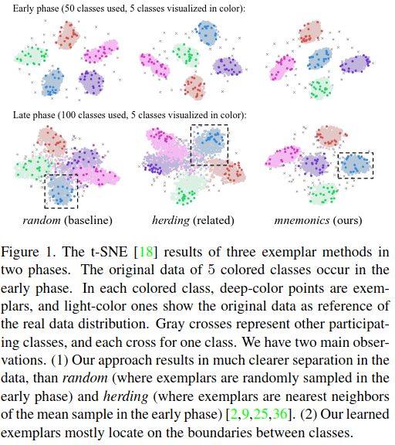
Learning-based exemplars selection
Mnemonics (Liu et al, 2020)
  Bi-level optimization program
  Model level and exemplar level
Updates the exemplars of past classes in each CL state
Requires a sophisticated training scheme, including a temporary model which needs to be stored
Notes:
Liu, Yaoyao, et al. "Mnemonics training: Multi-class incremental learning without forgetting." Proceedings of the IEEE/CVF conference on Computer Vision and Pattern Recognition. 2020.

Slide 7
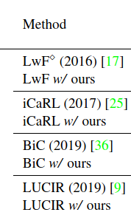
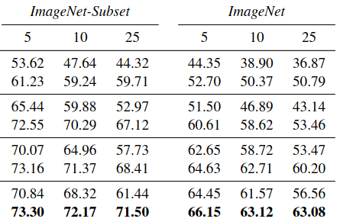
Herding vs Mnemonics
evaluation
Learning-based selection gives better performance
Mnemonics is applicable to different existing methods
The final performance gap between tested methods is reduced
The performance gap between different CL settings is reduced
The difference increases for longer incremental sequences
  More challenging setting since it requires more model updates

Slide 8
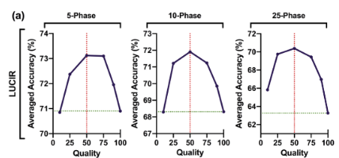
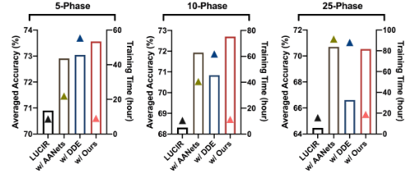
Data compression for efficient storage (Wang et al, 2022)
Consider a fixed storage budget
Uses determinal point processes to find a balance between image quality and number of samples per class
Accuracy improvement obtained for different existing methods
Computational cost close to that of herding
Notes:
Wang, Liyuan, et al. "Memory replay with data compression for continual learning." arXiv preprint arXiv:2202.06592 (2022).

Slide 9
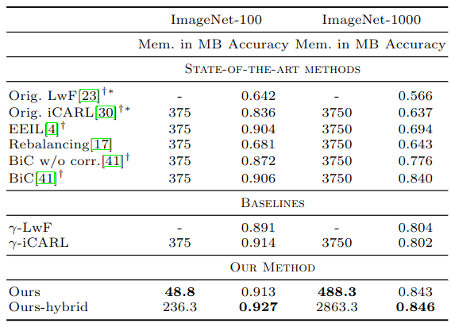
Feature-based buffers
(Iscen et al, 2020)
Stores features of past classes instead of images
Possible to keep more exemplar representation in a similar buffer
Adapt the features to make them compatible across CL states
  Requires the use of a feature adaptation network
  Implemented using an MLP
Performance improvement vs. image-based buffers
But the cost of the feature adaptation is not well analyzed
Notes:
Iscen, Ahmet, et al. "Memory-efficient incremental learning through feature adaptation." Computer Vision–ECCV 2020: 16th European Conference, Glasgow, UK, August 23–28, 2020, Proceedings, Part XVI 16. Springer International Publishing, 2020.

Slide 10
New data handling

Slide 11
Supervised CL assumptions
Most existing CL works assume that data are readily labeled
Strong assumption, particulary for embedded systems
  Data are collected on the go, possibly without an Internet connection
Making the CL process more realistic
  Novel class discovery (NCD) to structure new data automatically
  Active learning to select representative samples from new data
Notes:
Roy, Subhankar, et al. "Class-incremental novel class discovery." European Conference on Computer Vision. Cham: Springer Nature Switzerland, 2022.

Slide 12
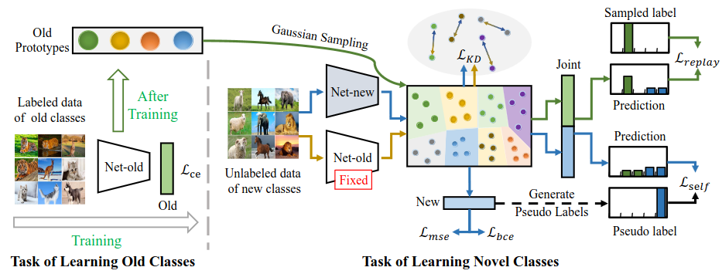
Incremental novel class discovery (Roy et al, 2022)
Clustering-based class discovery in CL setting
Supervised training + self-training to find new classes
Adds stochastic data augmentation to minimize adverse effects of pseudo-labeling
Stores features to represent past classes and updates them using feature distillation to avoid feature drift
Supervision is only needed to “name” the discovered classes
Notes:
Roy, Subhankar, et al. "Class-incremental novel class discovery." European Conference on Computer Vision. Cham: Springer Nature Switzerland, 2022.

Slide 13
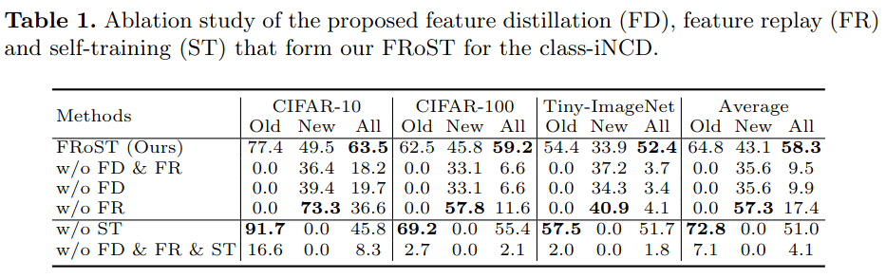
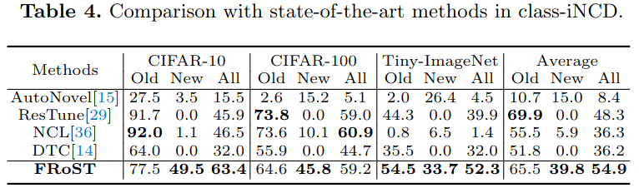
Evaluation of novel class discovery for CL
Ablation study - each component is important
Comparison with existing NCD methods is favorable
  Better balance of past and new classes for proposed method

Slide 14
Active learning for imbalanced CL (Belouadah et al, 2020)
Assumes that labels are not available for new data
  Only a part of new data are labeled manually
Also hypothesizes that classes are imbalanced
  Closer to real-life datasets
Adapts existing active learning schemes to a CL setting
  Reduce the imbalance of when performing active learning
Makes the CL process more realistic while reducing the annotation effort
But does not use all data for training, and penalizes accuracy
Notes:
Belouadah, Eden, et al. "Active class incremental learning for imbalanced datasets." European Conference on Computer Vision. Cham: Springer International Publishing, 2020.

Slide 15
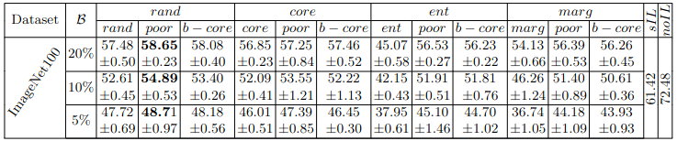
Evaluation
Annotation budget
Imbalance countering
Active learning strategy
Supervised CL
Standard learning
Results reported with fine tuning + thresholding to counter global imbalance of the dataset
Increasing the annotation budget brings performance closer to supervised CL, but comes at the cost
Random exemplar selection is a strong active learning baseline
  Performs better than more costly strategies such as coreset
Countering imbalance during active learning has positive effect

Slide 16
Neural architectures

Slide 17
Architecture adaptation for CL (Mirzadeh et al, 2022a)
Most existing works reuse existing network structures
  ResNet-18 classically, small versions of ViT more recently
Objective: study the influence of architecture width and depth in continual learning
  Focus on width instead of depth, which is put forward in most deep learning works
Tests done with Wide ResNet (WRN)
Notes:
Mirzadeh, Seyed Iman, et al. "Wide neural networks forget less catastrophically." International Conference on Machine Learning. PMLR, 2022.

Slide 18
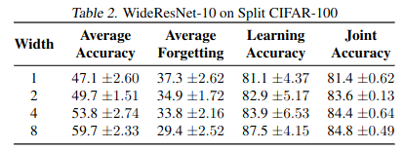
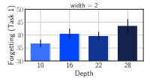
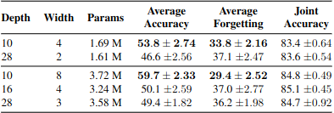
Evaluation of architecture adaptation
Done in a task-incremental learning setting
Increasing network width leads to better CL performance but memory footprint increases
Increasing network depth penalizes performance
  Likely caused by exploding gradients
Width should be prioritized for fixed parametric budgets
  Most interesting CL result

Slide 19
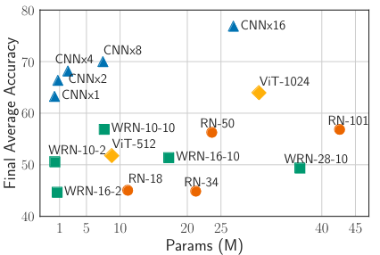
CNNs vs transformers
(Mirzadeh et al, 2022b)
CIFAR-100, 20 states x 5 classes
Comparison of different architectures with similar similar parametric footprint
Simple convolutional architectures with some structural modification behave competitively in CL
Visual transformers seem to have mediocre performance
  This conclusion is challenged in “Pretraining” section below
Performance is influenced by different architectural choices
Notes:
Mirzadeh, Seyed Iman, et al. "Architecture matters in continual learning." arXiv preprint arXiv:2202.00275 (2022).

Slide 20
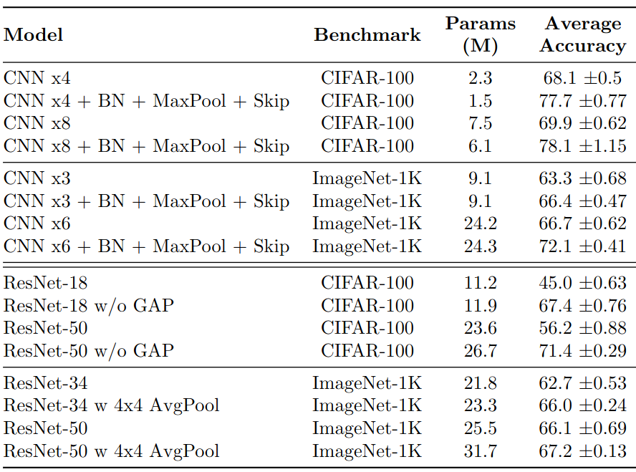
Architectural recipes
Favor width
CNNs
  Batch normalization
  Max pooling
  Use skip connections
ResNet - CIFAR
  Remove avg. pooling
ResNet - ImageNet 1k
  Local average pooling to increase the size of the embedding
  But at the cost of increasing the size of the models

Slide 21
Effects of pretraining

Slide 22
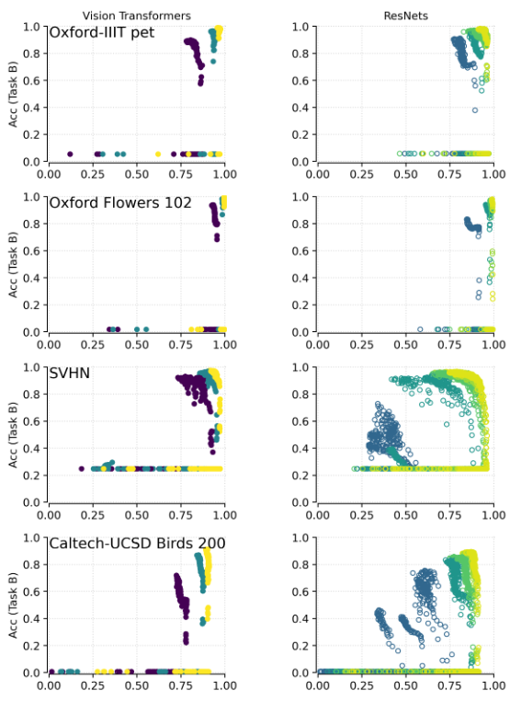
Scale of pretraining
(Ramasesh et al, 2022)
Transformers
ResNets
Setting
  Supervised pretraining - ImageNet-21k
  Only two tasks per dataset: A and B
  Plots accuracies for both tasks
Findings
  Network scale matters for both Transformers and ResNets
  Larger networks are more resilient
  Transformers have better behavior for large domain shift
Notes:
Ramasesh, Vinay Venkatesh, Aitor Lewkowycz, and Ethan Dyer. "Effect of scale on catastrophic forgetting in neural networks." International Conference on Learning Representations. 2021.

Slide 23
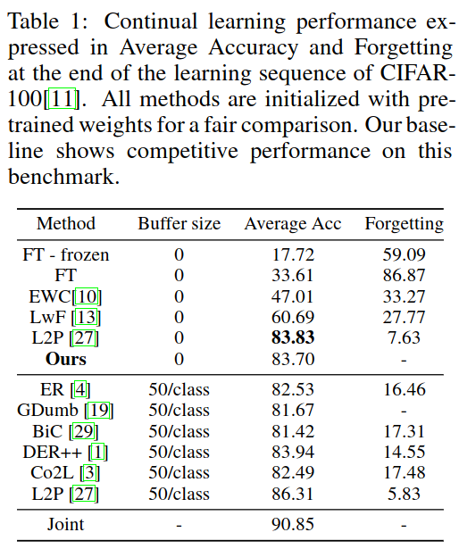
Pretraining baseline (Janson et al, 2022)
Methodology
  Pretraining on ImageNet-21k with a ViT-B/16 architecture
  Freeze initial model and use a nearest class mean classifier
Findings
  The proposed baseline, inspired by transfer learning is very strong
  Is pretraining the solution for CL?
Notes:
Janson, Paul, et al. "A simple baseline that questions the use of pretrained-models in continual learning." arXiv preprint arXiv:2210.04428 (2022).

Slide 24
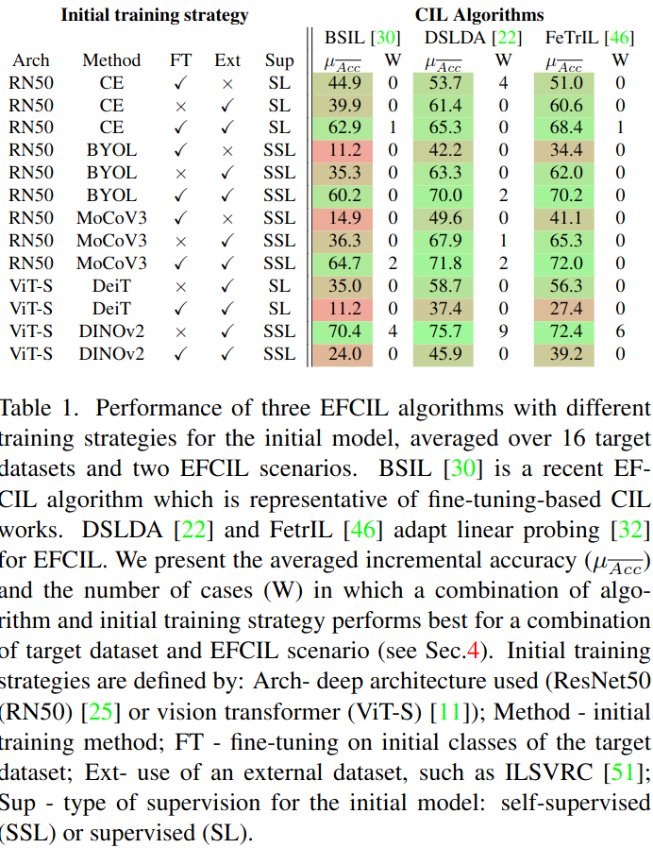
In-depth analysis of initial training strategies
Tests done with 16 diversified visual datasets and 2 CL settings
ViT-S with DINOv2 pretraining is the best strategy on average
  But not in all cases
Transfer-based methods do better than fine-tuning-based (BSIL)
  DSLA and FeTrIL are close
Self-supervised learning is a better option
  MoCoV3 is better than BYOL

Slide 25
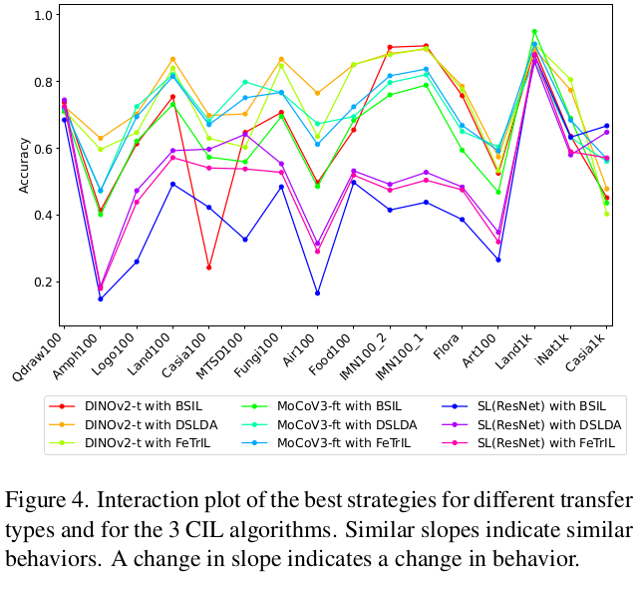
Per-dataset view
100 classes datasets
1k classes datasets
DINOv2 training + transfer-based CL is a good default choice
Supervised learning gives poor performance for most small datasets, but is competitive for larger datasets with domain shift

Slide 26
CL process complexity

Slide 27
Measuring complexity in CL
Timeliness is an important property of CL methods
  Rapidly evolving streams
  Computationally-constrained devices
Directly related to algorithmic complexity
But not discussed sufficiently in CL papers
Classical O-based complexity computation is not straightforward for deep networks
Both training and inference times should be considered

Slide 28
Training time comparison
CL setting: ImageNet-Subset with 50 initial + 10x5 classes
  Transfer-based vs fine-tuning based (PASS) methods
Measured time
  PASS ~11 hours on an NVIDIA V100 GPU
  NCM < 3 minutes on a single thread of Intel E5-2620v4 CPU
  FeTrIL ~ 75 minutes on a single thread of Intel E5-2620v4 CPU
  The time needed for DSLDA is similar to that for FeTrIL, but on GPU
Clear advantage for transfer-based methods
  Despite bias in favor of fine tuning methods (GPU vs CPU)
  They only train a linear classification layer
  FeTrIL can be further optimized with negative subsampling

Slide 29
Takeaways
Memory buffer - both selected samples and data quality matter
New data - go beyond supervised learning for improved realism
Neural architectures
  The width of the network has important effect in CL
  Other factors (batch normalization, pooling) also matter
Transfer-based methods are strong CL baselines
  The choice of the linear classifier is important
  Their complexity is much lower than that of fine tuning methods
The choice of the method should be guided by the practical application in which CL is deployed

Slide 30
Evaluation settings

Slide 31
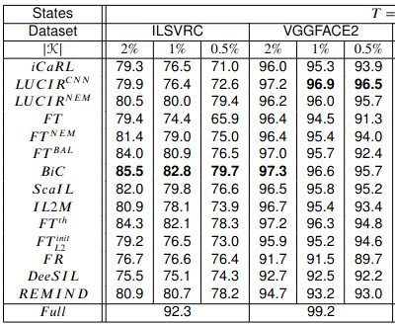
Memory buffer size
For image-based memory, all methods should use the same buffer size
If image- and feature-based memory are compared, use the same overall storage footprint
Vary the size of the memory buffer to assess method robustness
State clearly whether the size of the buffer is fixed or increases during the CL process
Notes:
Belouadah, Eden, Adrian Popescu, and Ioannis Kanellos. "A comprehensive study of class incremental learning algorithms for visual tasks." Neural Networks 135 (2021): 38-54.

Slide 32
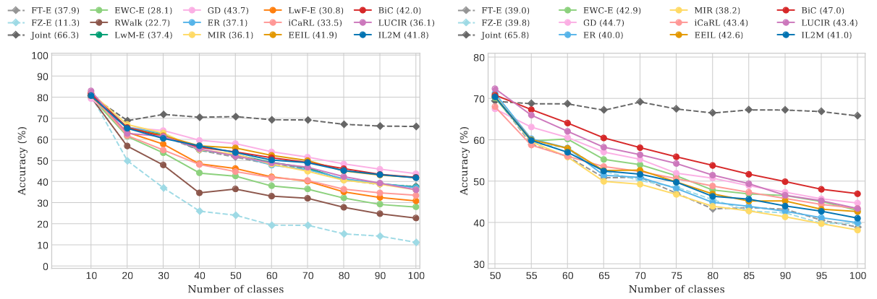
Class distribution in the CL stream
Ideally, diversified class distributions should be tested
  But the computational cost becomes prohibitive
Class distribution influences the performance of the methods
CIFAR 10 states x 10 classes
CIFAR 50 + 10 states x 5 classes
Notes:
Masana, Marc, et al. "Class-incremental learning: survey and performance evaluation on image classification." IEEE Transactions on Pattern Analysis and Machine Intelligence 45.5 (2022): 5513-5533.

Slide 33
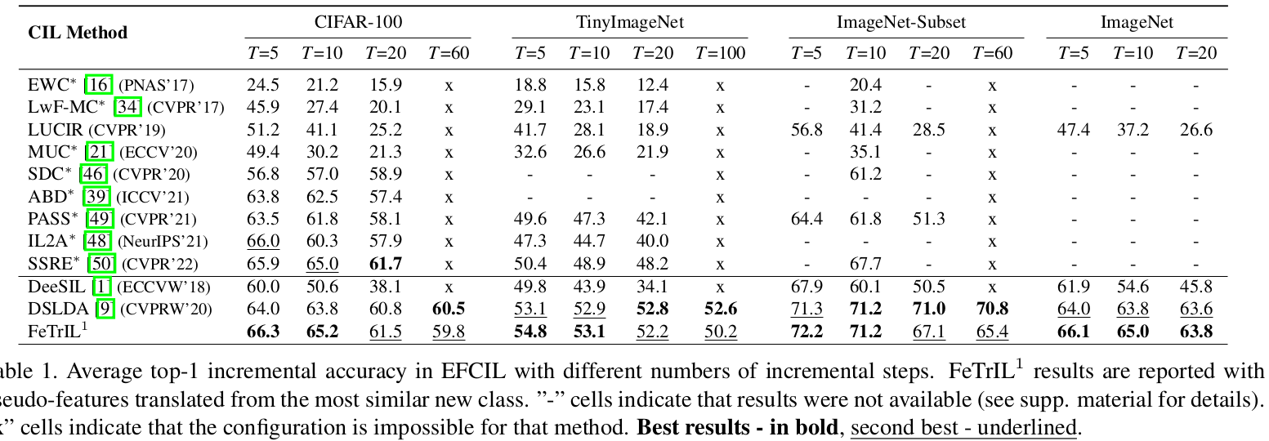
Class distribution in the CL stream
The size of the CL states has important impact on performance
Test challenging scenarios, such as one class per state

Slide 34
Diversity of the datasets
Small shift
Large shift
Test on at least three datasets, if possible designed for different visual tasks
Particularly important when pretraining is used to evaluate transferability of representations
Use challenging datasets as much as possible

Slide 35
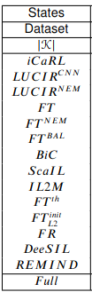
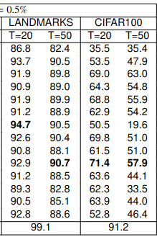
Size of the datasets
1000 classes
100 classes
An ideal CL method should be able to learn an infinite number of classes
  Large datasets (>= 1000 classes) are a good approximation
The number of classes in a dataset can have dramatic effect on the performance of some algorithms
  Validation set size is key for BiC

Slide 36
Pitfalls

Slide 37
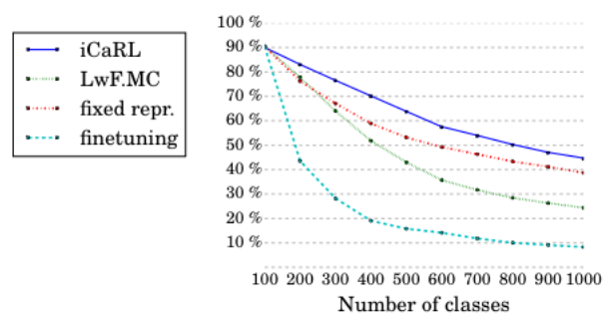

Memory buffer availability
iCaRL uses a memory buffer and is compared with fine tuning without memory
FT is behavior than iCaRL when a memory is added
Important due to high influence of iCaRL on further CL works
This flawed comparison pushed the use of knowledge distillation
  Later methods improved the use of this component
Notes:
Rebuffi, Sylvestre-Alvise, et al. "icarl: Incremental classifier and representation learning." Proceedings of the IEEE conference on Computer Vision and Pattern Recognition. 2017.

Slide 38
Optimization of baselines
iCaRL is compared with a transfer-based method which uses memory
The classifiers of the fixed representation are needlessly retrained in each CL state
  Suboptimal due to data imbalance
  Classifiers learned when classes occur the first time can be reused as such across states
Important because iCaRL justified the use of fine tuning with distillation in CL
Notes:
Rebuffi, Sylvestre-Alvise, et al. "icarl: Incremental classifier and representation learning." Proceedings of the IEEE conference on Computer Vision and Pattern Recognition. 2017.

Slide 39
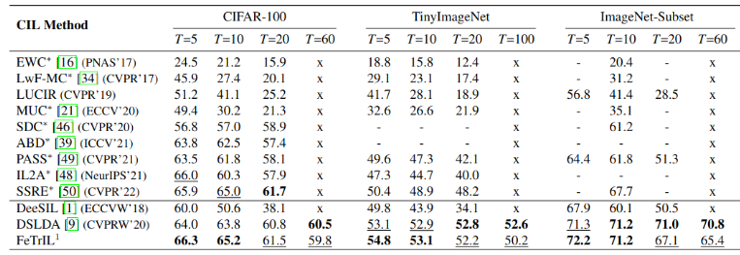
Optimization of baselines
With pretraining
Competitiveness of transfer based methods confirmed later
Particularly without a memory buffer
Without pretraining
Notes:
Petit, Grégoire, et al. "Fetril: Feature translation for exemplar-free class-incremental learning." Proceedings of the IEEE/CVF Winter Conference on Applications of Computer Vision. 2023.
Janson, Paul, et al. "A simple baseline that questions the use of pretrained-models in continual learning." arXiv preprint arXiv:2210.04428 (2022).

Slide 40
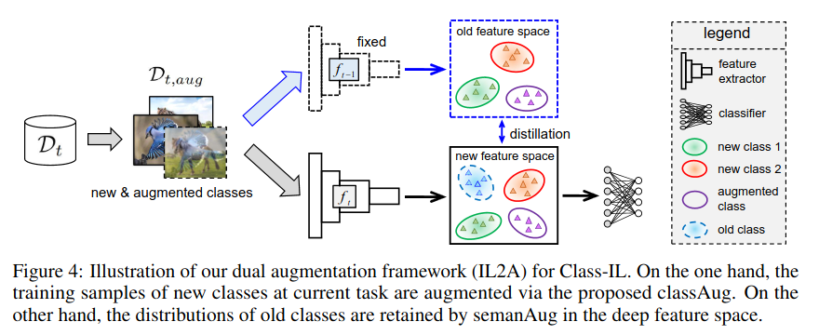
Memory requirements of the methods
IL2A (Zhu et al, 2021)
Memory should increase (very) slowly
512 x 512 per class for Resnet-18 -> 262 MB storage for 1000 classes
This should be the main experiment
Notes:
Zhu, Fei, et al. "Class-incremental learning via dual augmentation." Advances in Neural Information Processing Systems 34 (2021): 14306-14318.

Slide 41
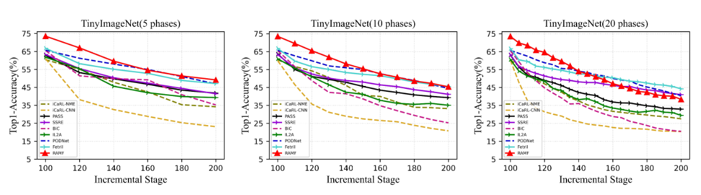
Initial training strategy
The same training strategy should be used for all methods
Otherwise, unfair advantage for those which use data/class augmentations
Notes:
Song, Ke, et al. "Non-exemplar Class-incremental Learning by Random Auxiliary Classes Augmentation and Mixed Features." arXiv preprint arXiv:2304.07707 (2023).

Slide 42
Availability of external data
Pretraining has become prevalent lately and is now considered acceptable in CL
  Not necessarily the case before
Very useful for transfer-based methods
It is ok to use pretraining, but state this clearly
When possible test the methods with and without pretraining

Slide 43
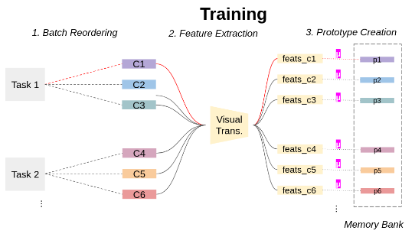
Don’t forget the past (catastrophically)
(Pelosin, 2022), (Janson et al, 2022):
  Pretrained transformer + nearest class mean (NCM)
iCaRL (2017)
  CNN internal training + NCM
DeeSIL (2018)
  CNN internal training/pretraining + SVMs
DSLDA (2020)
  CNN pretraining + SLDA
Notes:
Pelosin, Francesco. "Simpler is better: off-the-shelf continual learning through pretrained backbones." arXiv preprint arXiv:2205.01586 (2022).

Slide 44
Good practice for CL evaluation
Provide a clear description of the hypotheses made
Use several data stream structures
  Initial data, size of the increments
Make sure that all tested methods are compared fairly
  Memory buffer, data stream structure, datasets etc.
Use diversified datasets in order to evaluate robustness
  Particularly important when pretraining with external data is used
Test with datasets of different sizes
  Scale matters in continual learning

