Slide 1
Continual Learning for Image Classification
Course 3: Methods
Adrian Popescu
adrian.popescu@cea.fr

Slide 2
Overview
Exemplar-based continual learning (EBCIL)
Exemplar-free continual learning (EFCIL)

Slide 3
Exemplar-based continual learning

Slide 4
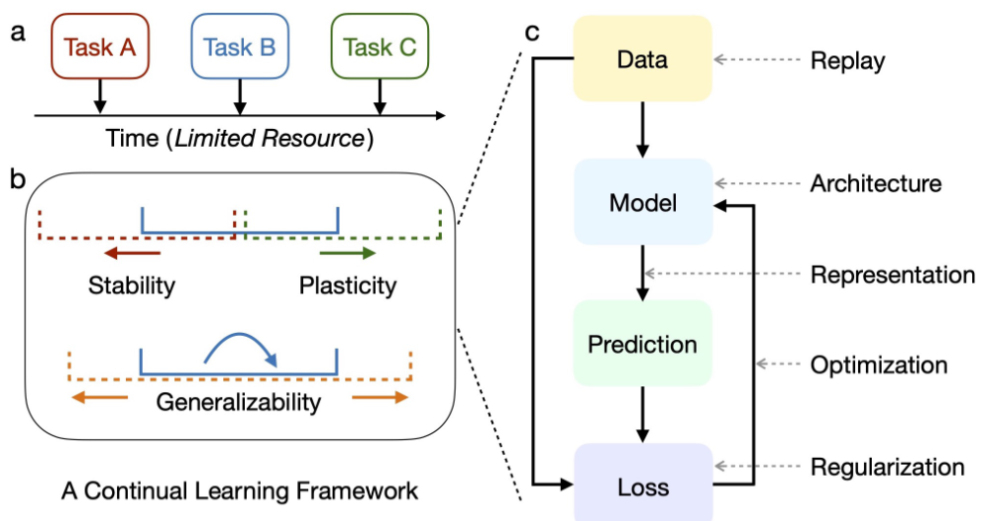
Generic continual learning framework
Notes:
Wang, Liyuan, et al. "A comprehensive survey of continual learning: Theory, method and application." arXiv preprint arXiv:2302.00487 (2023).

Slide 5
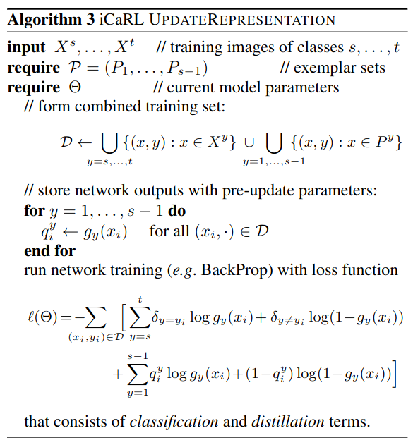
iCaRL (Rebuffi et al, 2017)
Very influential CIL method
Memory buffer to counter catastrophic forgetting
Adapts learning without forgetting to a CIL context
Fine tuning with distillation
Iterative distillation to pass past knowledge to the current model
Notes:
Rebuffi, Sylvestre-Alvise, et al. "icarl: Incremental classifier and representation learning." Proceedings of the IEEE conference on Computer Vision and Pattern Recognition. 2017.
Li, Zhizhong, and Derek Hoiem. "Learning without forgetting." IEEE transactions on pattern analysis and machine intelligence 40.12 (2017): 2935-2947.

Slide 6
iCaRL (Rebuffi et al, 2017)
Uses a nearest class mean classifier to counter imbalance between past and new classes
Applicable to exemplar-based and exemplar free class-incremental learning (EBCIL and EFCIL)
Attention given to the selection of exemplars
Efficiency
  The training process is long since all layers of the model are tuned
  The complete formulation requires the storage of exemplars

Slide 7
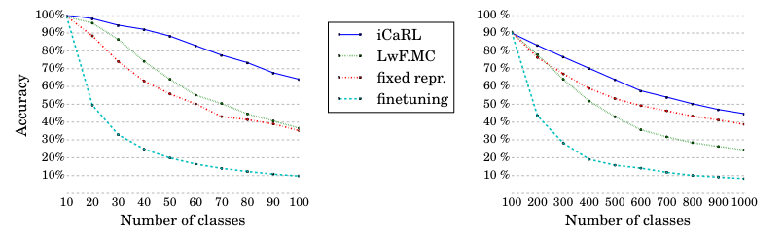
iCaRL evaluation (Rebuffi et al, 2017)
Tests on three datasets, with up to 1000 classes
ResNet-18 backbone
A single data stream structure
Good performance w.r.t. baselines
Evaluation is unfair - see next course for details

Slide 8
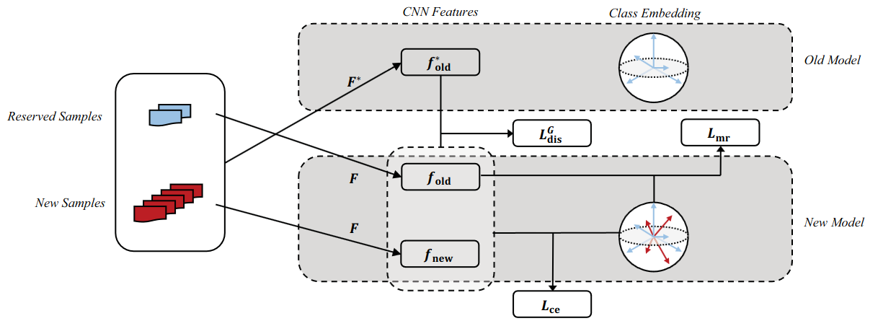
LUCIR (Hou et al, 2019)
Inspired by iCaRL in terms of CL setting and hypotheses
Refined formulation of the loss to ensure a better balance between stability and plasticity
End-to-end approach since imbalance is handled by the CNN classifier
Notes:
Hou, Saihui, et al. "Learning a unified classifier incrementally via rebalancing." Proceedings of the IEEE/CVF conference on computer vision and pattern recognition. 2019.

Slide 9

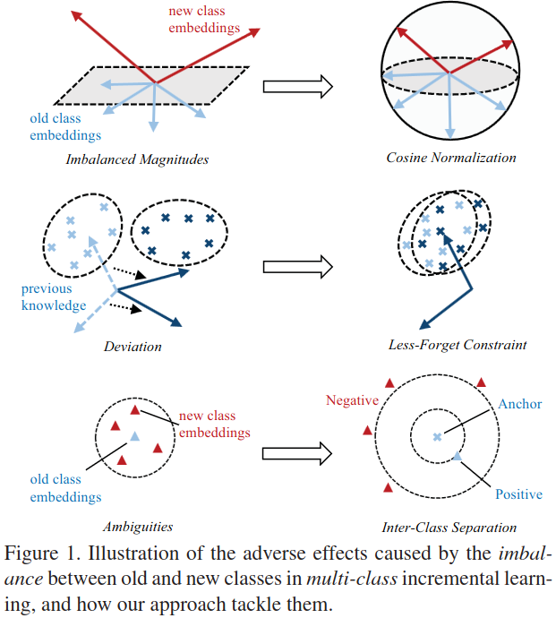




LUCIR (Hou et al, 2019)
Handles both forgetting and inter-class separation
Focused on the embeddings space instead of the outputs space
Notes:
Hou, Saihui, et al. "Learning a unified classifier incrementally via rebalancing." Proceedings of the IEEE/CVF conference on computer vision and pattern recognition. 2019.

Slide 10
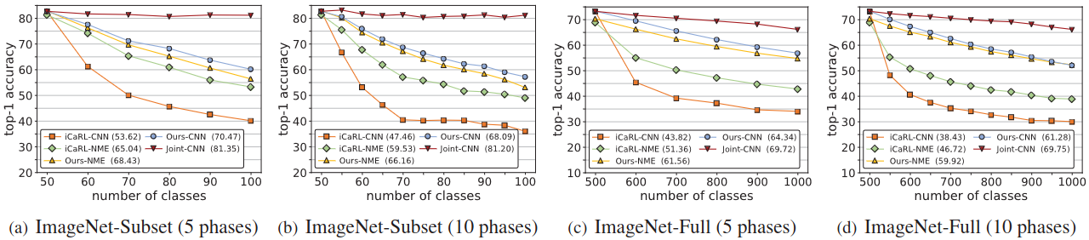
LUCIR Evaluation (Hou et al, 2019)
Scenario similar to iCaRL, but:
  Half of the classes initially and the memory is bounded locally
Large gains compared to iCaRL, particularly for 1000 classes
The method works well with half of the classes initially
  The gain w.r.t. iCaRL is lower if classes are distributed evenly
Notes:
Hou, Saihui, et al. "Learning a unified classifier incrementally via rebalancing." Proceedings of the IEEE/CVF conference on computer vision and pattern recognition. 2019.

Slide 11
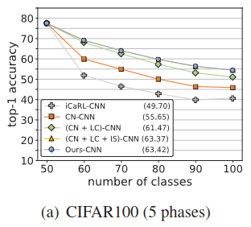
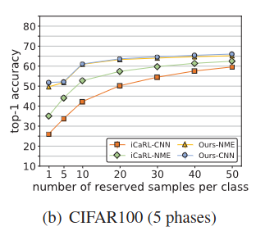
LUCIR Evaluation (Hou et al, 2019)
Ablation study - important in order to assess the contribution of each component of the proposed approach
Most of the gain is brought by cosine normalization and embedding-based distillation
Memory buffer ablation - good performance obtained starting from 10 samples per class
Notes:
Hou, Saihui, et al. "Learning a unified classifier incrementally via rebalancing." Proceedings of the IEEE/CVF conference on computer vision and pattern recognition. 2019.

Slide 12
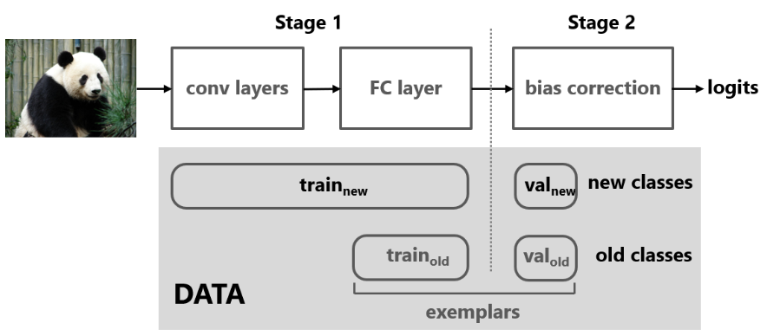
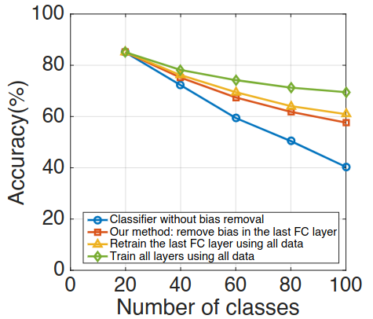
BiC (Wu et al, 2019)
Also inspired by iCaRL but adds a bias correction layer
Requires a memory buffer
Interesting diagnosis of the classification layer
  Upper bound: standard training
  Lower bound: no bias removal
Results close to those of training the classification layer with all data
CIFAR-100 5x20 classes
Notes:
Wu, Yue, et al. "Large scale incremental learning." Proceedings of the IEEE/CVF conference on computer vision and pattern recognition. 2019.

Slide 13
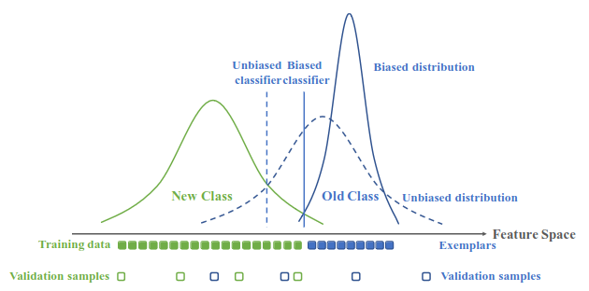
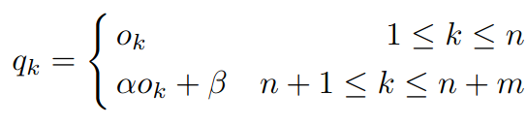
BiC (Wu et al, 2019)
Combined loss using cross entropy and distillation in the output space
Narrow distribution of past classes in the feature space due to imbalance -> bias toward new classes
Use of a validation set to reduce the bias
Parameters are learned to reduce prediction scores for new classes
Simple yet effective method

Slide 14
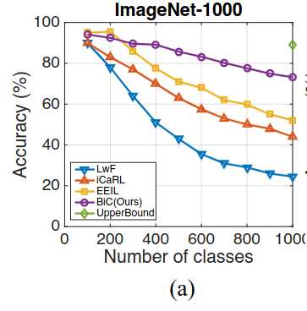
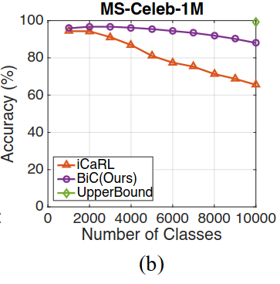
BiC evaluation (Wu et al, 2019)
Evaluation setting inspired from iCaRL
Tests with up to 10,000 classes
  Useful to demonstrate scalability
Performance largely improved compared to iCaRL and EEIL
The accuracy gap increases toward the end of the CL process
Limitation: not usable without memory since a exemplars of past classes are required

Slide 15
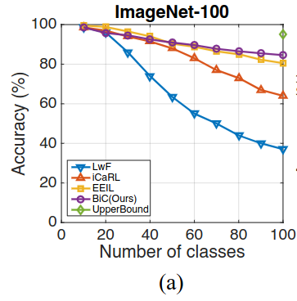
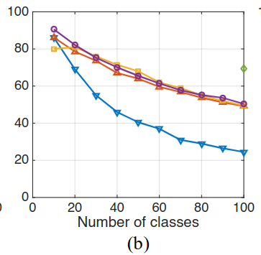
BiC evaluation (Wu et al, 2019)
Results at small scale (100 classes)
Performance of baselines is much closer to that of BiC compared to 1,000 and 10,000 classes
The gaps are different for the two datasets
Takeaways
  The scale of evaluation datasets matters
  The evaluation on different datasets is important
CIFAR-100

Slide 16
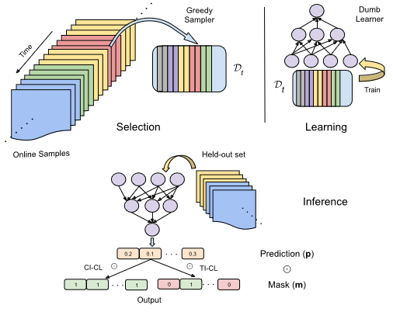
GDumb (Prabhu et al, 2020)
Generic approach
  Doable with any data stream structure
  Requires a memory of the past
  Performs batch training
Greedy Sampler and Dumb Learner
  Selects samples so a to have balance samples across classes
  Trains each model from scratch - no fine tuning
Inference can be done with or without task IDs
Notes:
Prabhu, Ameya, Philip HS Torr, and Puneet K. Dokania. "Gdumb: A simple approach that questions our progress in continual learning." Computer Vision–ECCV 2020: 16th European Conference, Glasgow, UK, August 23–28, 2020, Proceedings, Part II 16. Springer International Publishing, 2020.

Slide 17
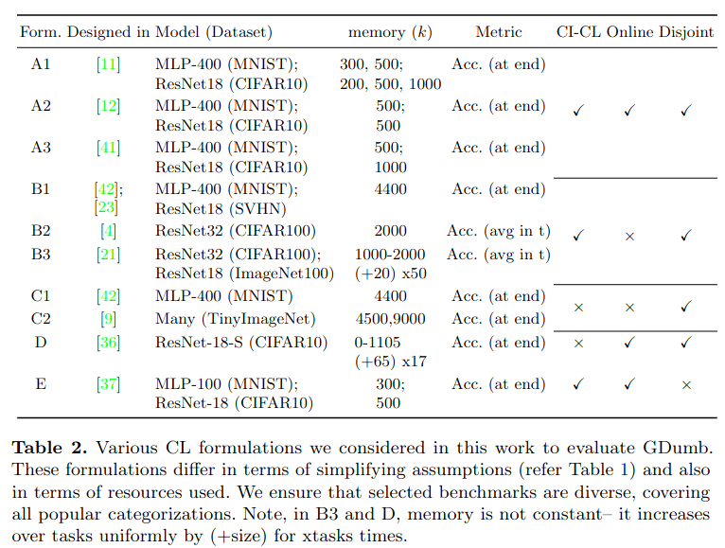
GDumb experiments
Online class-based CL
Offline class-based CL
Offline task-based CL
Online task-based CL
Online class-based CL

Slide 18
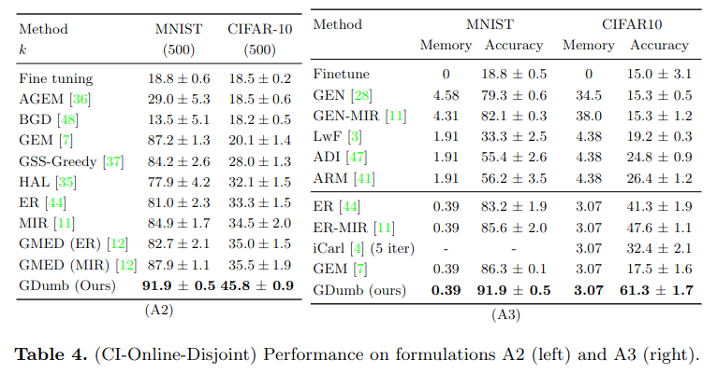
GDumb for online class-based CL

Slide 19
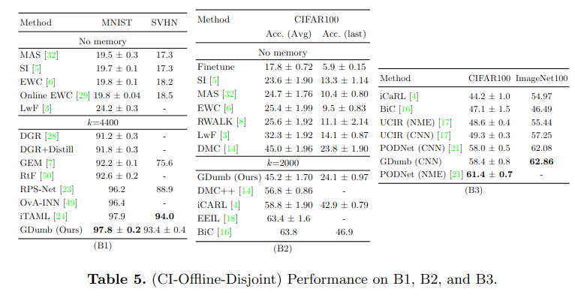
GDumb for offline class-based CL

Slide 20
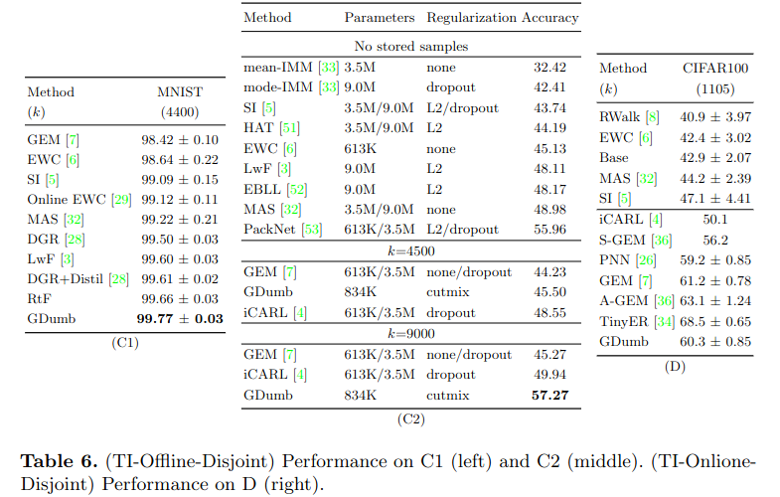
GDumb for offline and online task-based CL

Slide 21
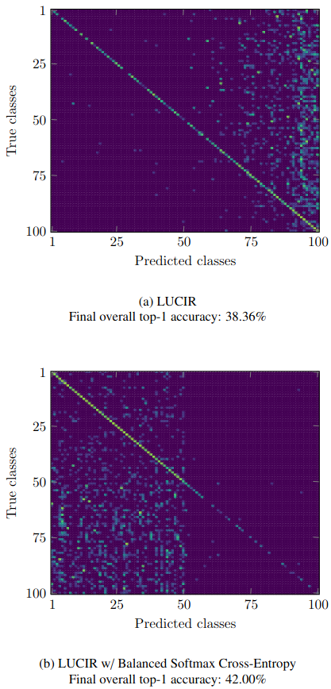
BSIL (Jodelet et al, 2022)
Focuses on bias correction by modifying the softmax computation
Inspired by work on imbalanced learning for long tail class recognition
Usable with and without memory buffer
The proposed component can be plugged in different existing methods
Reduces the overall classification bias
  Favors past classes over new ones
ImageNet-100 50 + 5x10 steps
Notes:
Jodelet, Quentin, Xin Liu, and Tsuyoshi Murata. "Balanced softmax cross-entropy for incremental learning with and without memory." Computer Vision and Image Understanding 225 (2022): 103582.

Slide 22



BSIL with memory buffer
Modified softmax
Control of
imbalance
Control of past class importance
Elegant formulation of the loss function
Fine grained control of the importance of past classes
Meta-learning to obtain an optimal value of ɑ
Learned jointly during the training of the neural network
Distillation loss
Total loss
Control of distillation importance

Slide 23
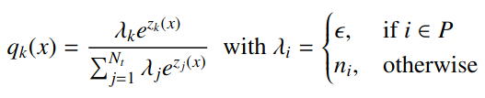
BSIL without memory buffer
Adaptation of the method for a CL scenario without exemplars of the past
Simple solution which uses a constant to simulate their presence
Gives high importance to past classes to ensure stability
X
No memory buffer
Small positive number to be selected

Slide 24
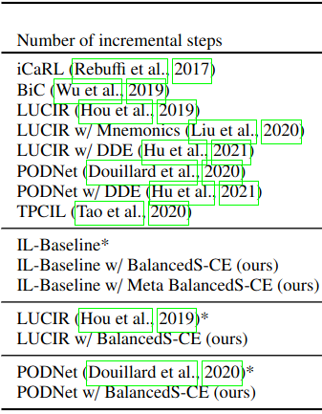
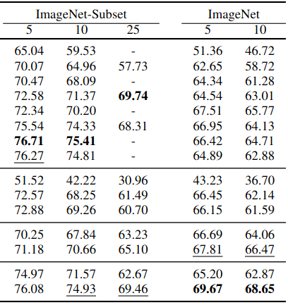
BSIL with memory buffer
evaluation
Tests against many competitive baselines
Good performance of baseline + BSIL
Half of classes initially + three/two incremental splits; 20 exemplars of past classes kept
Scale matters
  Results are close to those of baselines for 100 classes
  BSIL is better for the 1000 classes, a more challenging setting
The relative gains compared to the baseline methods used is also larger for 1000 classes

Slide 25
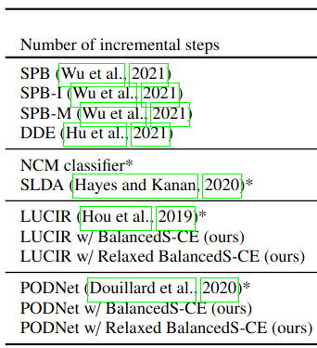
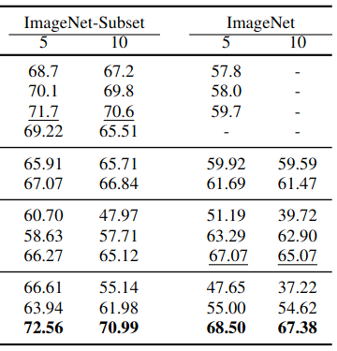
BSIL without memory
buffer evaluation
Tests against recent methods
Performance gains are important at large scale
Half of classes initially + two incremental splits
The proposed method is more robust to the change of CL scenario (5 vs 10 incremental states)
Transfer-based methods behave competitively compared to the other baselines

Slide 26
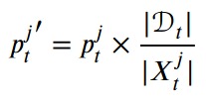
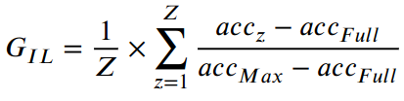
A comparative study of exemplar-based CL
Boosting the predictions of past classes
Performed in 2020 using SotA methods at the time
  iCaRL, BiC, LUCIR
  But also FT variants - baseline without distillation
    Notably thresholding inspired by imbalanced learning
Comprehensive evaluation
  Varied the size of the memory buffer (K)
  Varied the number of incremental states (T)
Tested with CL states of equal size
Introduced a global score to assess performance
Notes:
Belouadah, Eden, Adrian Popescu, and Ioannis Kanellos. "A comprehensive study of class incremental learning algorithms for visual tasks." Neural Networks 135 (2021): 38-54.

Slide 27
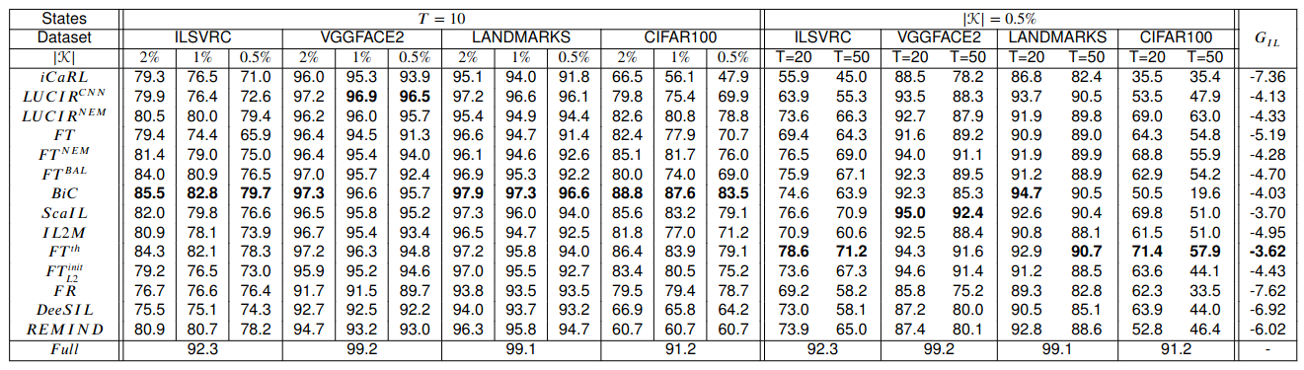
A comparative study of exemplar-based CL
iCaRL has one of the lowest overall scores. Close to that of FR - i.e. naive transfer learning
BiC is provides good performance when the memory buffer is large, but fails otherwise
FT+ tresholding is a very strong baseline. Was there actual progress in CL at the time?

Slide 28
A comparative study of exemplar-based CL
Bias reduction works reasonably well without distillation
Performance gaps between continual and standard learning are larger for difficult datasets
CL is very challenging with small increments and a small memory buffer

Slide 29
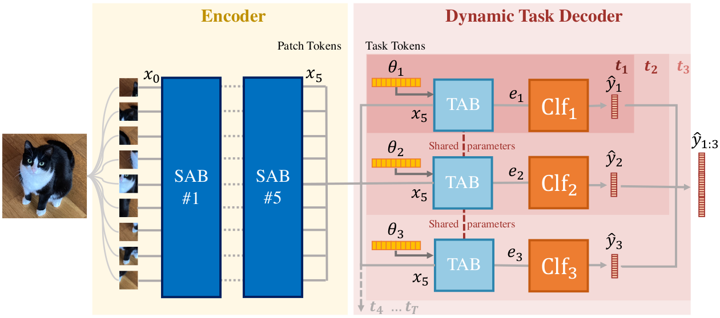
DyTox
(Douillard et al, 2022)
Replaces CNNs with transformers
The encoder and decoder are shared between all tasks
The forward parts of the decoders are specialized per task
Improved training using MixUp to improve training

Slide 30
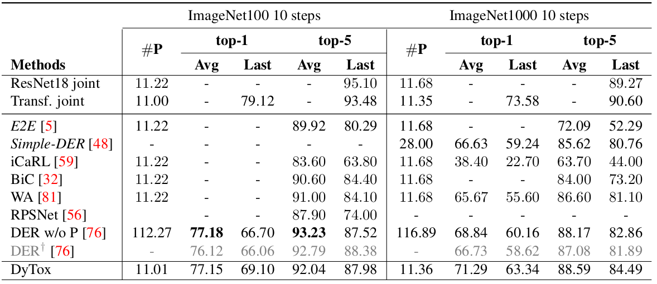
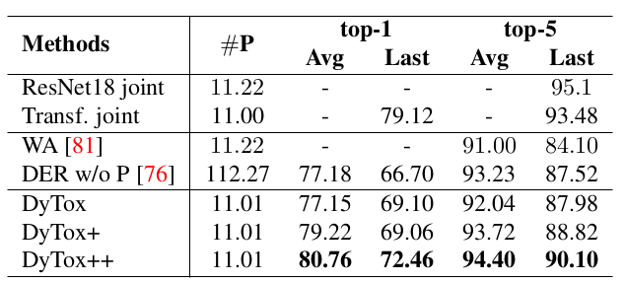
DyTox
evaluation
Comparison with recent methods which use CNN backbone models
Results obtained by DyTox are better than those of methods which have similar parametric footprint
The gain is partly explained by the use of data augmentation to improve the training procedure

Slide 31
Exemplar-free continual learning

Slide 32
Generic continual learning framework
X
Notes:
Wang, Liyuan, et al. "A comprehensive survey of continual learning: Theory, method and application." arXiv preprint arXiv:2302.00487 (2023).

Slide 33
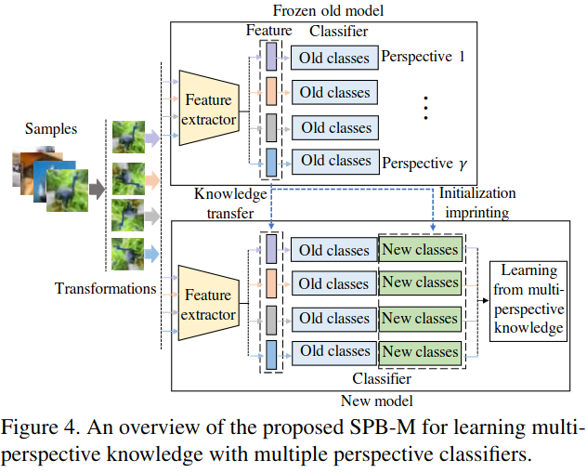
SPB (Wu et al, 2021)
Heavily inspired by LUCIR, with focus on exemplar-free CL
Replaces the distillation term of the loss by an L2-distance in the feature space
Adds rotations as augmentations to obtain a more robust representation
Notes:
Wu, Guile, Shaogang Gong, and Pan Li. "Striking a balance between stability and plasticity for class-incremental learning." Proceedings of the IEEE/CVF International Conference on Computer Vision. 2021.

Slide 34
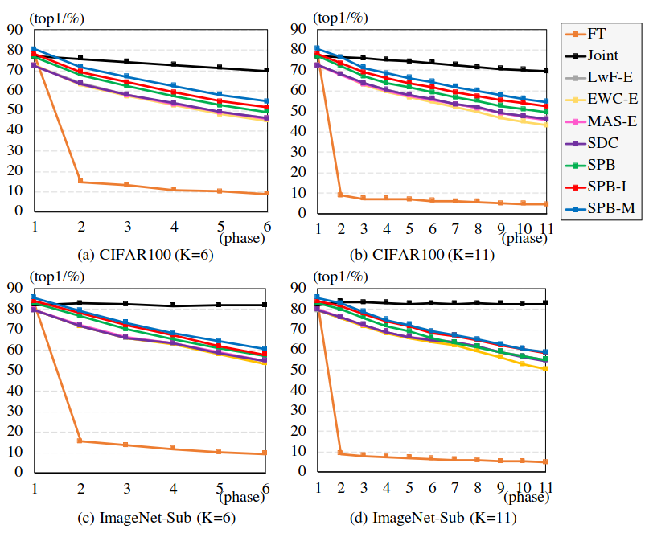
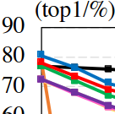
SPB evaluation (Wu et al, 2021)
Improved performance compared to that obtained by other EFCIL methods which use adapted fine-tuning
Small gains brought by the data augmentation
But with a more complex training process due to class augmentations
The gain is partly explained by the initial gain of performance provided by the augmentation
Notes:
Wu, Guile, Shaogang Gong, and Pan Li. "Striking a balance between stability and plasticity for class-incremental learning." Proceedings of the IEEE/CVF International Conference on Computer Vision. 2021.

Slide 35
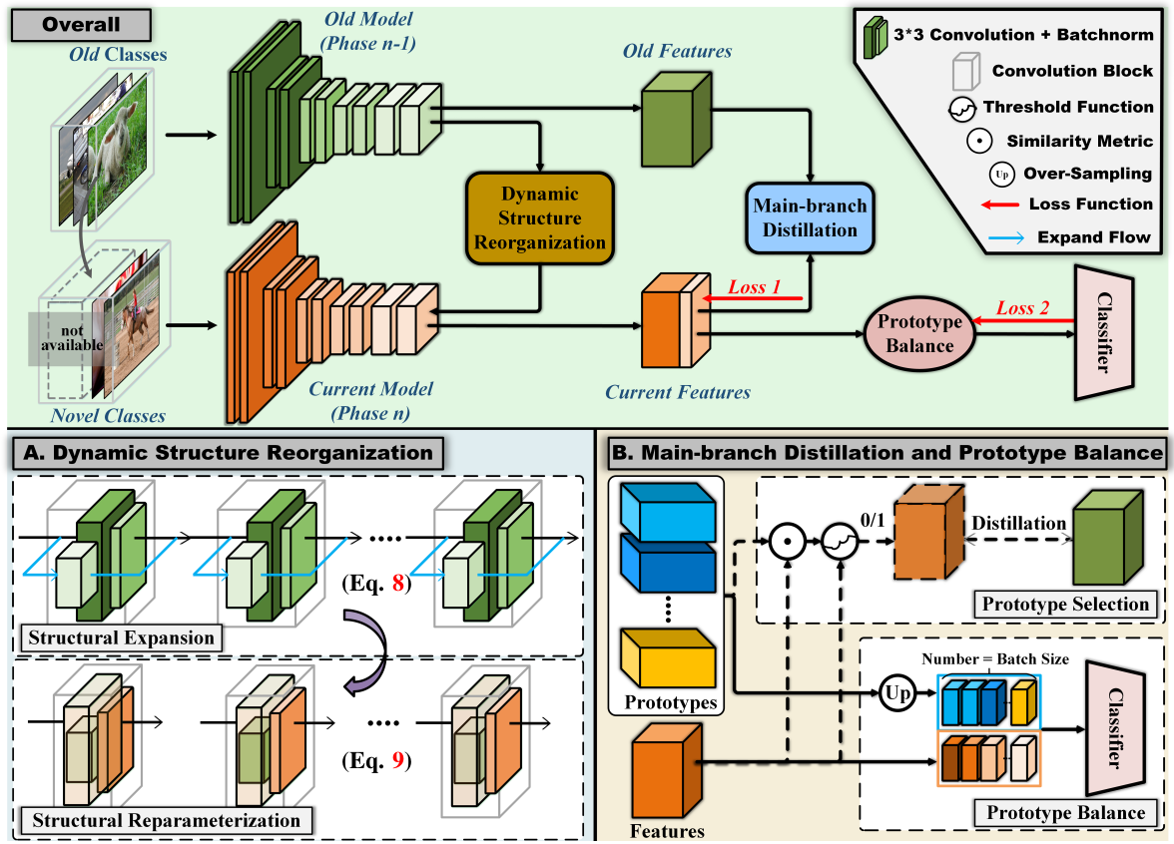
SSRE (Zhu et al, 2022)
The method combines
  Backbone architecture reorganization using residual adapters
  Prototypes of past classes which are over-sampled
  Oversamping of prototypes to counter imbalance
Notes:
Zhu, Kai, et al. "Self-sustaining representation expansion for non-exemplar class-incremental learning." Proceedings of the IEEE/CVF Conference on Computer Vision and Pattern Recognition. 2022.

Slide 36
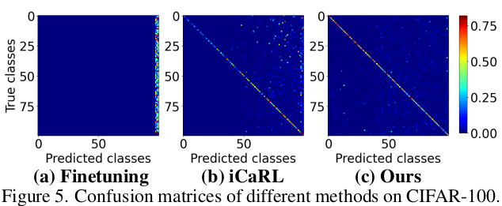
SSRE (Zhu et al, 2022)
Interesting method but complex
  The architecture changes over time
  The regularization is done with a composite loss
  Prototype selection for new classes to increase performance
Illustration of the bias removal obtained with SSRE

Slide 37
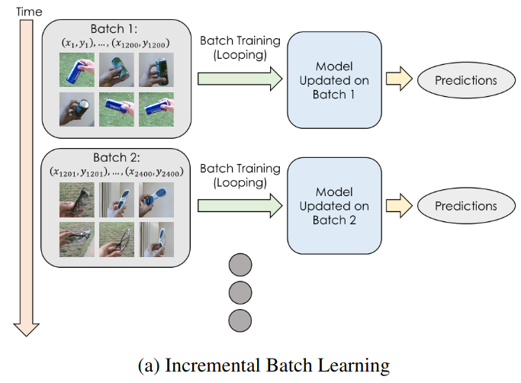
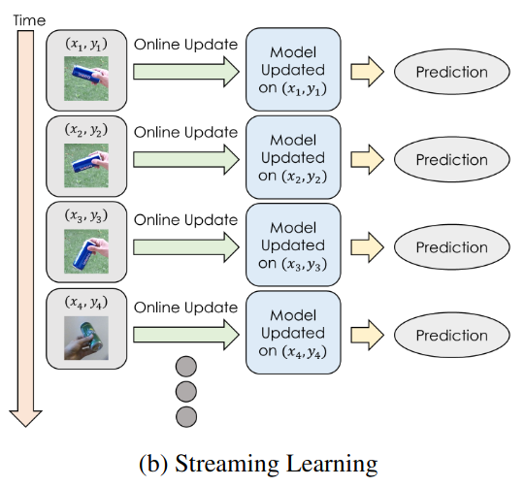
DSLDA (Hayes & Kanan, 2020)
Uses a frozen feature extractor
  Pretrained or trained initially
Updates only the classification layer
  Inspired by transfer learning
Addresses both efficacy and efficiency of the CL process
Adaptable for stream and batch learning
Notes:
Hayes, Tyler L., and Christopher Kanan. "Lifelong machine learning with deep streaming linear discriminant analysis." Proceedings of the IEEE/CVF conference on computer vision and pattern recognition workshops. 2020.

Slide 38
DSLDA (Hayes & Kanan, 2020)
Assumes that the embedding provided by the frozen extractor are transferable to data which occurs later in the CL process
The classification is based on:
  The running mean of each class
  A shared covariance matrix
Refined version of nearest class mean (iCaRL)
The mean and matrix are updated when new classes occur
Entails the storage of a covariance matrix
  d x d, with d - size of the embedding

Slide 39
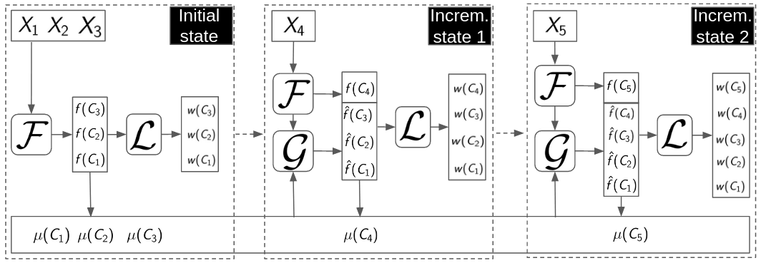
FeTrIL (Petit et al, 2023)
Also inspired by transfer learning
Uses a (very) simple feature generator to create pseudo-features of past classes
Trains discriminative linear classifiers with data of new classes and pseudo-features of past classes in each CL state
  Class separability is enabled since all classes are represented
Needs to store the prototypes (mean representations) of past classes
Notes:
Petit, Grégoire, et al. "Fetril: Feature translation for exemplar-free class-incremental learning." Proceedings of the IEEE/CVF Winter Conference on Applications of Computer Vision. 2023.

Slide 40
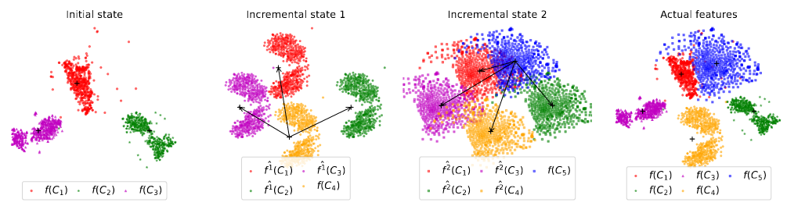
FeTrIL (Petit et al, 2023)
Pseudo-features generation for past classes by geometric translation of actual features of new classes
When several new classes are available, translation is made from the one which is closest in the representation space

Slide 41
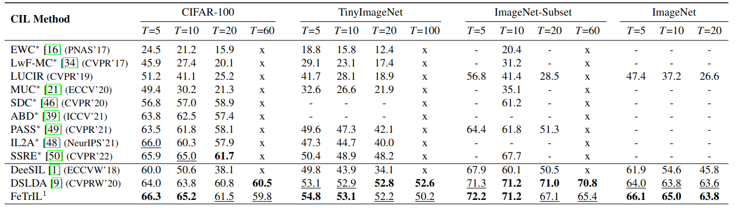
EFCIL
evaluation
Half of the classes
in the initial state;
100 or 200 classes per dataset
BSIL (CVIU, 2022)
72.6 71.0
68.5 67.4
Transfer-based methods have competitive performance
  BSIL (published concurrently) does better, but complex training
FeTrIL is better for large increments
  Discriminative classifiers are better with “good pseudo-features
DSLDA is better for small increments - stream learning
Fine-tuning methods cannot work with 1-class increments

Slide 42
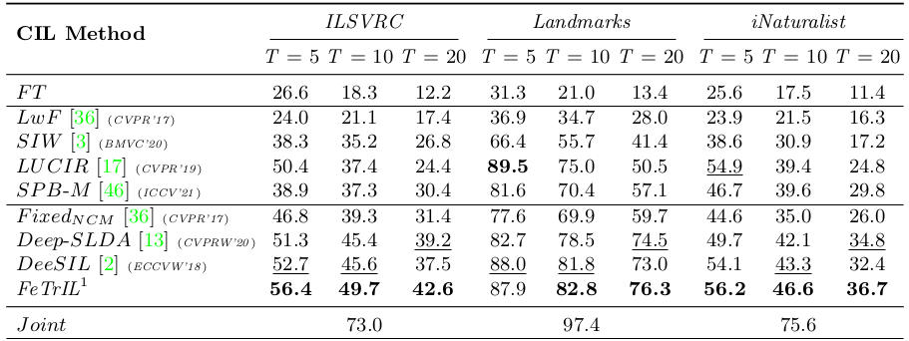
EFCIL
evaluation
Even distribution of classes in CL states;
1000 classes per dataset
Transfer-based methods again have competitive performance
FeTrIL is better in a majority of cases
  Each incremental state includes sufficient classes for a “good” generation of pseudo-features
All results are presented with an initial training which uses only data from the initial state
  Transfer-based methods can be easily plugged on top of pretrained models (discussed in the next course)

Slide 43
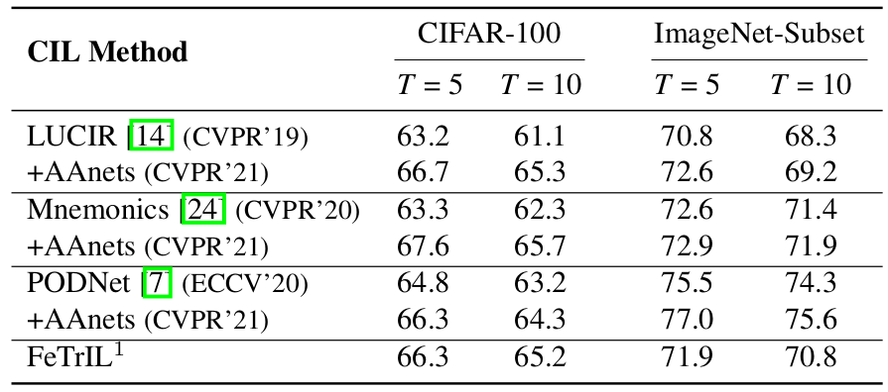
EBCIL vs EFCIL
evaluation
iCaRL, 2017: 20 - 30 points de différence entre EBCIL et EFCIL
BSIL,
2022
 | CIFAR-100 |  | ImageNet-subset |  | ImageNet
 | T=5 | T=10 | T=5 | T=10 | T=5 | T=10
EFCIL | 67.8 | 66.6 | 76.1 | 74.9 | 69.7 | 68.7
EBCIL | 65.7 | 63.82 | 72.6 | 70.1 | 68.5 | 67.4
There still is a gap between CL with and without memory
However, this gap has significantly narrowered between 2017 and today
The importance of memory is decreasing
FeTrIL, 2023

Slide 44
Takeaways
There is performance progress over time in CL, but the gap with standard learning remains important
  Particularly for small incremental states and small memory buffer
The gap between CL with and without memory buffer became narrower recently
Simple methods provide good performance
  The usefulness of distillation is questionable
  The efficacy-efficiency balance is in favor of transfer-based methods

