Slide 1
Continual Learning for Image Classification
Course 2: Challenges and Approaches
Adrian Popescu
adrian.popescu@cea.fr

Slide 2
Overview
Catastrophic forgetting / interference
Stability - plasticity balance
A taxonomy of CL methods
Desirable properties of CL methods

Slide 3
Catastrophic forgetting

Slide 4
An old problem
“New learning may interfere catastrophically with old learning when networks are trained sequentially. The analysis of the causes of interference implies that at least some interference will occur whenever new learning may alter weights involved in representing old learning” (McCloskey & Neal, 1989)
“Unfortunately, though, catastrophic forgetting does occur under certain circumstances in distributed connectionist networks. The very features that give these networks their remarkable abilities to generalize, to function in the presence of degraded input, and so on, are found to be the root cause of catastrophic forgetting.” (French, 1999)
Notes:
McCloskey, Michael, and Neal J. Cohen. "Catastrophic interference in connectionist networks: The sequential learning problem." Psychology of learning and motivation. Vol. 24. Academic Press, 1989. 109-165.
French, Robert M. "Catastrophic forgetting in connectionist networks." Trends in cognitive sciences 3.4 (1999): 128-135.

Slide 5
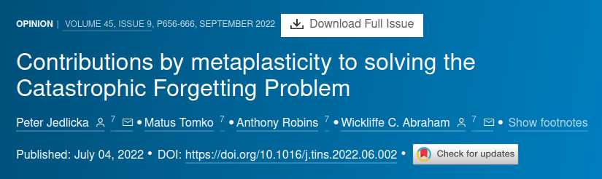
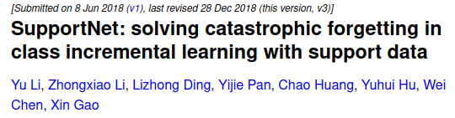
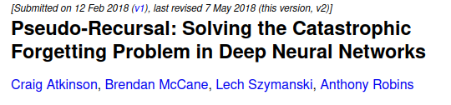
Yet to be solved
Despite numerous claims of the contrary
There is always a price to pay
  Large memory buffer
  Strong increase of the parametric footprint
  Use of external data

Slide 6
Catastrophic forgetting (French, 1999)
Analysis inspired from interference in animals
Hypothesis: gradual forgetting in higher mammals because of the hippocampal-neocortical separation
Distributed neural networks
  Learning of new patterns changes the weights space
  “Weight cliffs” - “moving even small distances over the weight-landscape would radically disrupt prior learning”
Notes:
French, Robert M. "Catastrophic forgetting in connectionist networks." Trends in cognitive sciences 3.4 (1999): 128-135.

Slide 7
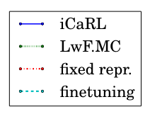
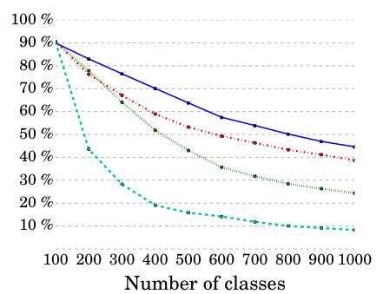
Accuracy in continual learning (2017)
Standard learning
Drastic drop in accuracy if nothing is done to prevent forgetting
Exemplar-free is below exemplar-based CL
  But there is a storage cost
The performance gap compared to standard learning is large
Exemplar based CL
Exemplar free CL
Catastrophic forgetting
ImageNet LSVRC,
10 x 100 classes
Notes:
Rebuffi, Sylvestre-Alvise, et al. "icarl: Incremental classifier and representation learning." Proceedings of the IEEE conference on Computer Vision and Pattern Recognition. 2017.

Slide 8
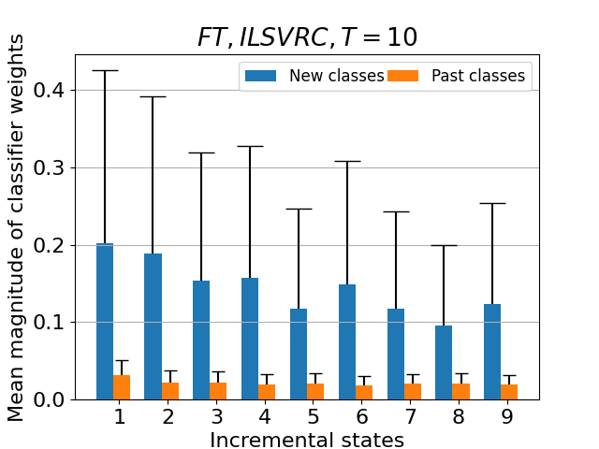
Catastrophic forgetting - analysis of classifier weights
Classical fine tuning without exemplars to illustrate the effect of forgetting
The weights of past classes are significantly lower than those of new classes
Results are basically random for past classes
ImageNet LSVRC, 10 x 100 classes

Slide 9
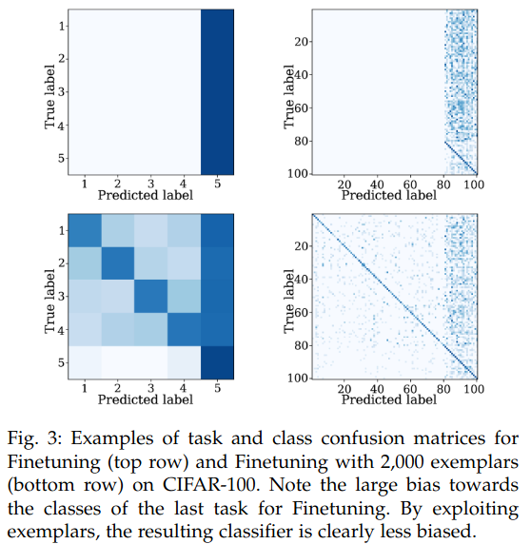
Catastrophic forgetting - analysis of predictions
(Masana et al, 2022)
Classical fine tuning without and with exemplars
Strong bias toward the new classes in absence of exemplars
The bias is reduced when exemplars are used, but the bias is still important
Effect of sample imbalance between past and new classes
Exemplar free CL
Exemplar based CL
Notes:
Masana, Marc, et al. "Class-incremental learning: survey and performance evaluation on image classification." IEEE Transactions on Pattern Analysis and Machine Intelligence 45.5 (2022): 5513-5533.

Slide 10
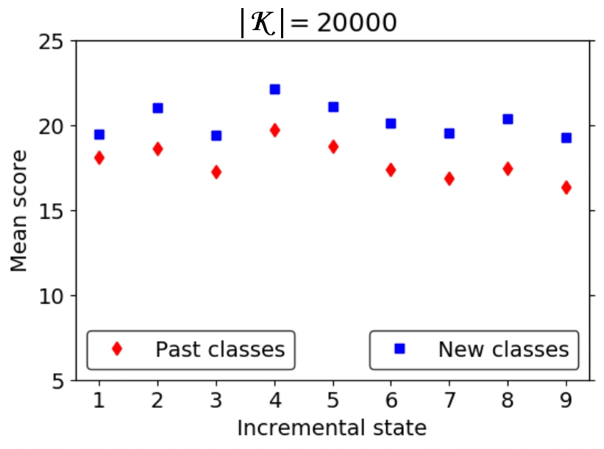
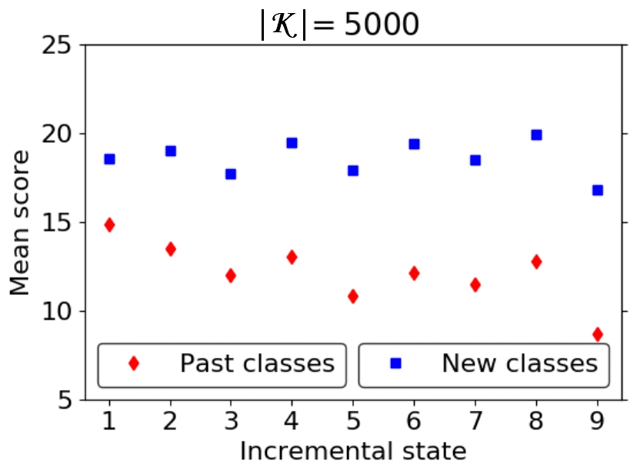
Catastrophic forgetting - role of exemplars buffer size
Classical fine tuning with exemplars - 20k vs 5k exemplars
Mean prediction scores for past and new classes
A larger memory buffer clearly helps, but entails a storage cost

Slide 11
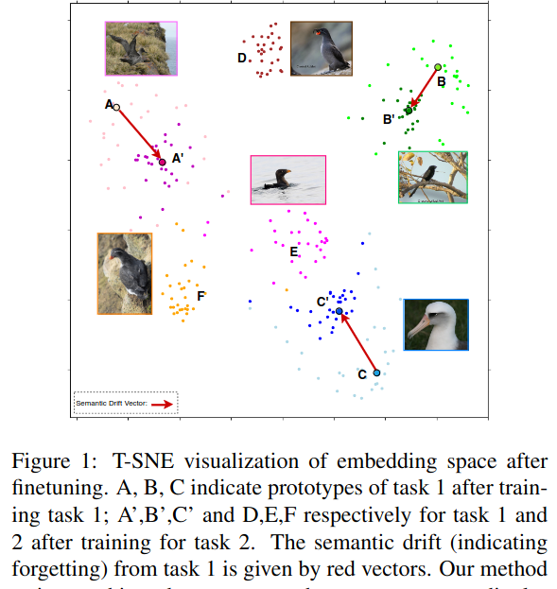
Semantic drift (Yu et al, 2020)
The representations of classes move in the representation space when new classes are ingested
The drift is larger without rehearsal due to lack of exemplars for past classes
Notes:
Yu, Lu, et al. "Semantic drift compensation for class-incremental learning." Proceedings of the IEEE/CVF conference on computer vision and pattern recognition. 2020.

Slide 12
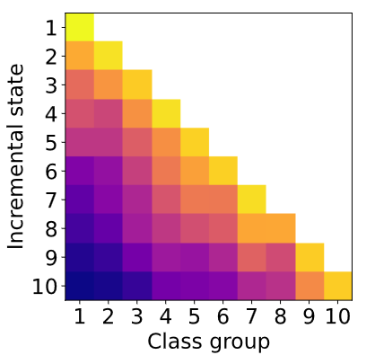
Recency bias
LwF (Li & Hoiem, 2010)
for CIFAR-100 10x10
Accuracy for classes learned in different CL states in an exemplar-free scenario
Forgetting generally increases as classes become “older”
Important to adapt the measures taken against forgetting per CL state
Time
Recency
Notes:
Li, Zhizhong, and Derek Hoiem. "Learning without forgetting." IEEE transactions on pattern analysis and machine intelligence 40.12 (2017): 2935-2947.

Slide 13
Takeaways regarding catastrophic forgetting
Inherent to neural architectures updates due to changes in the weights space
Hard (intractable?) problem in exemplar-free CL if no parameter expansion is allowed
Forgetting is progressive in exemplar-free CL
A memory buffer reduces forgetting, but there still is bias toward new classes
  Due to sample imbalance
  Intuitively, the larger the buffer is, the smaller the bias will be
  But the storage cost increases linearly with the buffer size

Slide 14
Stability - plasticity balance

Slide 15
A strong dilemma when learning continually
The representations learned in CL should be
  Stable - to preserve knowledge of the past
  Plastic - to ingest new data and represent them properly
A trade-off between the two properties is usually sought
  100% plasticity = catastrophic forgetting
  100% stability = no forgetting, but no room for accommodating new class representations
The weight given to each of the two properties depends on the CL scenario which is implemented

Slide 16
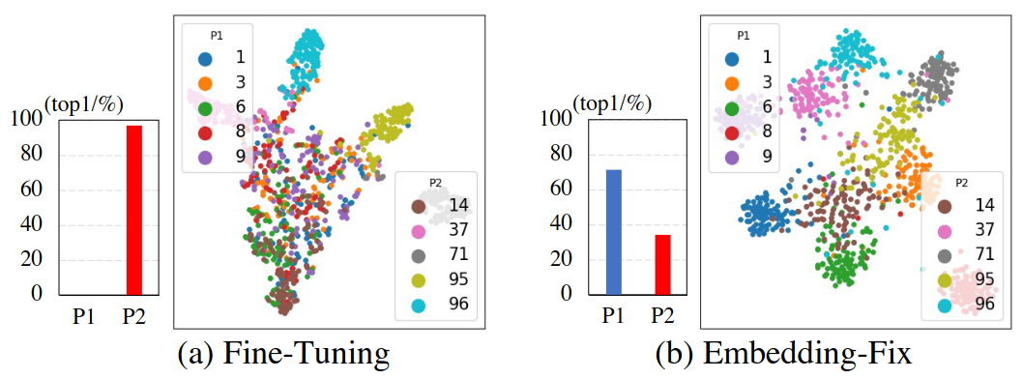
Illustration of extreme approaches
100% plasticity
100% stability
Notes:
Wu, Guile, Shaogang Gong, and Pan Li. "Striking a balance between stability and plasticity for class-incremental learning." Proceedings of the IEEE/CVF International Conference on Computer Vision. 2021.

Slide 17
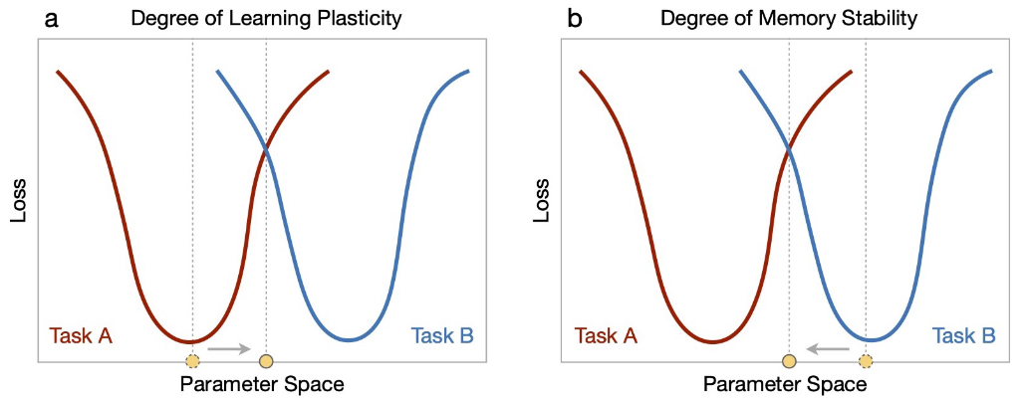
Representation of the parameter space
The compromise between plasticity and stability entails a higher loss value, and performance reduction
Notes:
Wang, Liyuan, et al. "A comprehensive survey of continual learning: Theory, method and application." arXiv preprint arXiv:2302.00487 (2023).

Slide 18
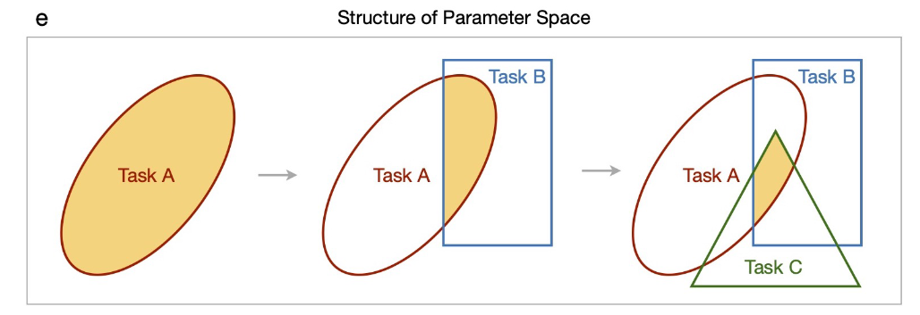
Representation of the parameter space
The compromise becomes more and more difficult to find as new data are ingested since the shared parameter space is narrowing
Notes:
Wang, Liyuan, et al. "A comprehensive survey of continual learning: Theory, method and application." arXiv preprint arXiv:2302.00487 (2023).

Slide 19
Addressing the stability-plasticity balance
Use a memory buffer
  Simple and effective strategy if exemplars can be stored
  And if a relatively large storage overhead is allowed
Use a generative model for samples of past classes
  The quality of generated images is the main challenge
  The training process becomes more complex
  The generative models themselves suffer from catastrophic forgetting

Slide 20
Addressing the stability-plasticity balance
Use knowledge distillation to preserve past knowledge when updating deep models
  Adaptation of distillation to a continual context
  Most frequently used method to counter forgetting
  Loss formulation
L = Lc + Ld
The balance between the two components is not straightforward
Implementations discussed in the next course
Lc - cross-entropy loss - plasticity component
Ld - distillation loss - stability component
Notes:
Hinton, Geoffrey, Oriol Vinyals, and Jeff Dean. "Distilling the knowledge in a neural network." arXiv preprint arXiv:1503.02531 (2015).

Slide 21
Addressing the stability-plasticity balance
Favor stability by updating only the classification layer
  Inspired by transfer learning
  Minority approach in CIL
No backpropagation = no forgetting
But plasticity is limited
  Importance of starting with an initial model which generalizes well
Approaches depending of assumptions on data
  Internal data - train a feature extractor only with initial classes
  External data - use a pretrained feature extractor
Implementations discussed in the next course

Slide 22
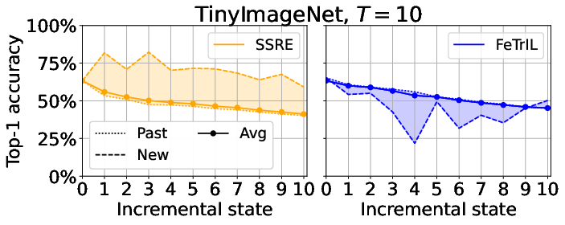
A practical example for class-incremental learning
Accuracy of past and new classes should be similar
Plasticity-oriented methods favor new classes, but they are in minority an the overall accuracy is lower
Plasticity-oriented method
Stability-oriented method

Slide 23
Takeaways regarding stability-plasticity balance
A compromise between the two properties is needed
Difficult to find, particularly when the number of states increases
The weight given to each of the properties should depend on the CL scenario
Different solutions are possible, but their applicability is conditioned by the assumptions made about the CL process
  Memory, complexity of training etc.

Slide 24
A taxonomy of CL methods

Slide 25
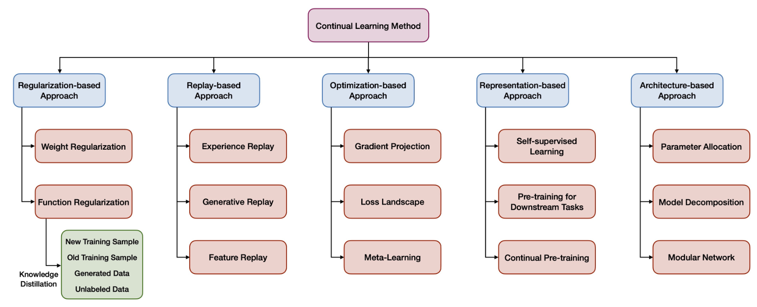
Many solutions for many CL scenarios
Notes:
Wang, Liyuan, et al. "A comprehensive survey of continual learning: Theory, method and application." arXiv preprint arXiv:2302.00487 (2023).

Slide 26
Many solutions for many CL scenarios
Notes:
Wang, Liyuan, et al. "A comprehensive survey of continual learning: Theory, method and application." arXiv preprint arXiv:2302.00487 (2023).

Slide 27
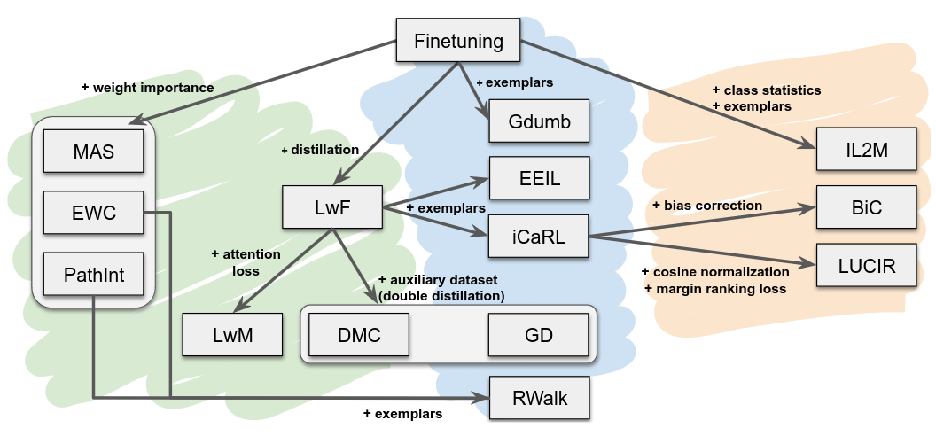
Zooming on class-incremental learning (Masana et al, 2022)
Notes:
Masana, Marc, et al. "Class-incremental learning: survey and performance evaluation on image classification." IEEE Transactions on Pattern Analysis and Machine Intelligence 45.5 (2022): 5513-5533.

Slide 28
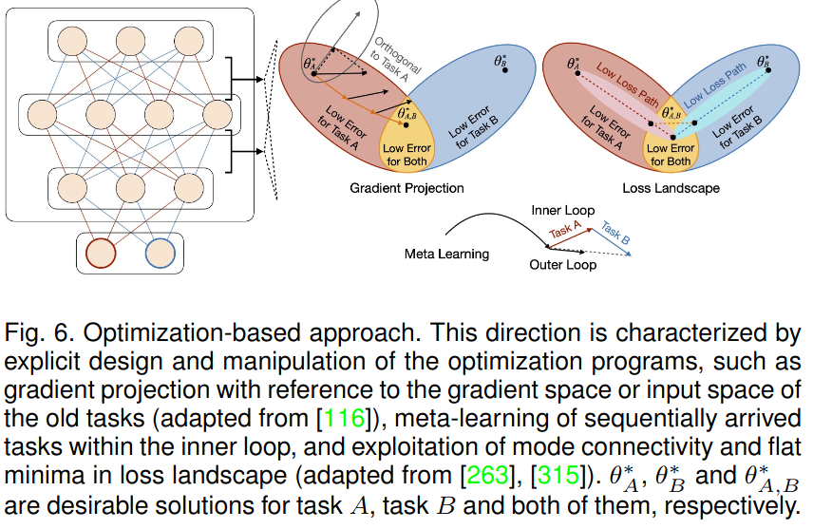
Optimization based approaches
Gradient projection - explicit modification of parameter updates to accommodate past and new knowledge
Meta-learning - obtain a data-driven inductive bias for CL scenarios
Loss landscape - obtain robust representations and convergence to wider loss basins
Notes:
Wang, Liyuan, et al. "A comprehensive survey of continual learning: Theory, method and application." arXiv preprint arXiv:2302.00487 (2023).

Slide 29
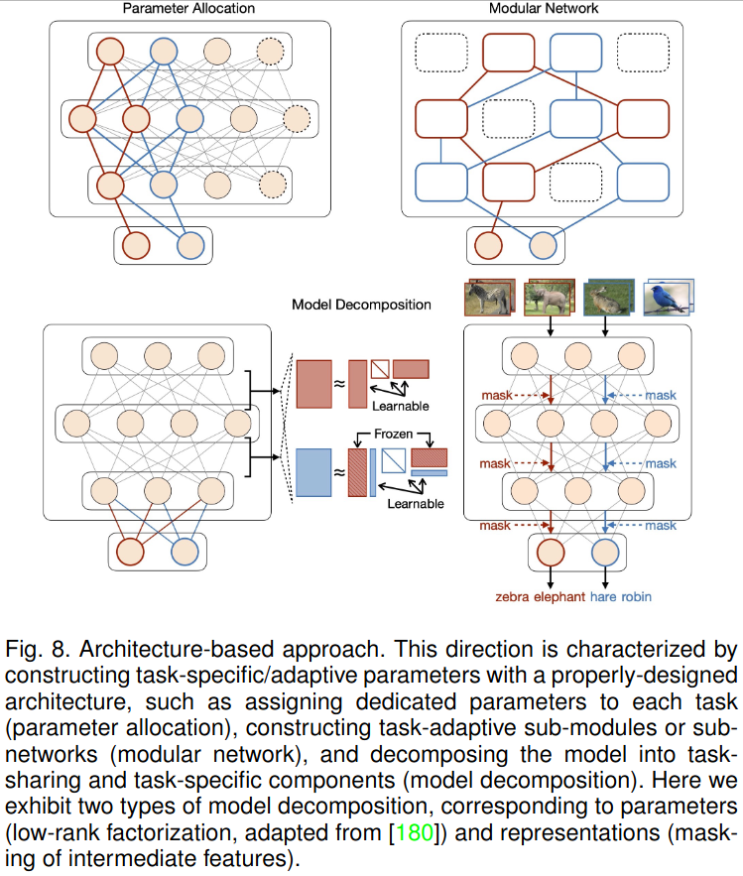
Architecture-based approaches
Parameter allocation - parameter subspace per task, with fixed or dynamic architectures
Modular networks -parallel sub-networks or sub-modules for CL tasks trained in a differentiated manner
Model decomposition - separation of models into (fixed) task-sharing and (expandable) task-specific components
Notes:
Wang, Liyuan, et al. "A comprehensive survey of continual learning: Theory, method and application." arXiv preprint arXiv:2302.00487 (2023).

Slide 30
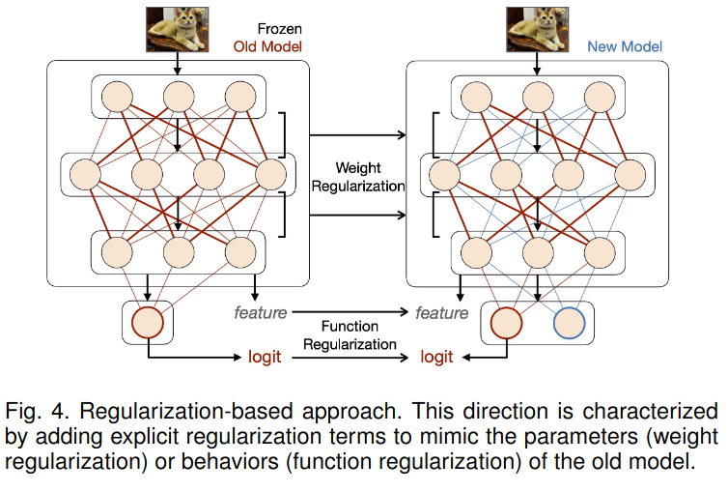
Regularization-based approaches
Weights regularization - regularizes the variation of parameters based on their contribution to old tasks
Function regularization - focus on intermediate or final outputs of the prediction function
  Adaptation of knowledge distillation to an CL context
  Often combined with replay or generation of past data
Notes:
Wang, Liyuan, et al. "A comprehensive survey of continual learning: Theory, method and application." arXiv preprint arXiv:2302.00487 (2023).

Slide 31
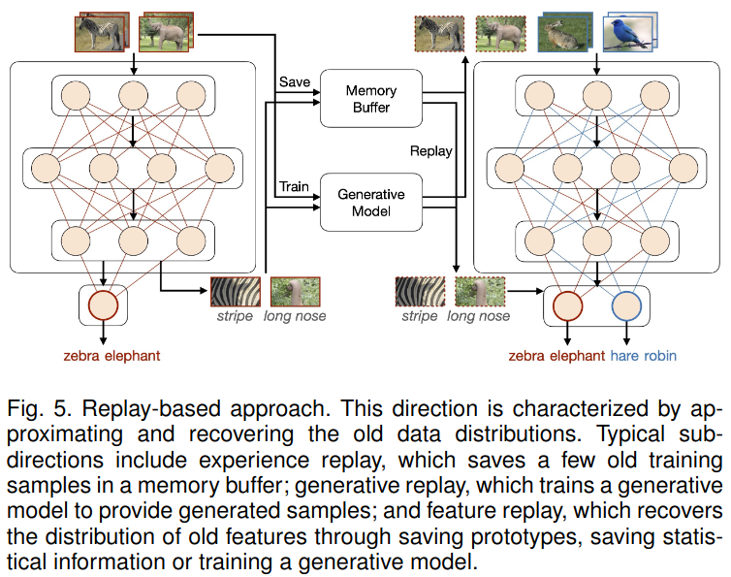
Replay-based approaches
Experience replay - storage and use of a small memory buffer
  Importance of how to select exemplars and reuse the buffer
Generative replay with an auxiliary model to create past data
  GAN, VAE, diffusion model
Feature replay
  More efficient and than generative replay
  But prone to representation shift
Notes:
Wang, Liyuan, et al. "A comprehensive survey of continual learning: Theory, method and application." arXiv preprint arXiv:2302.00487 (2023).

Slide 32
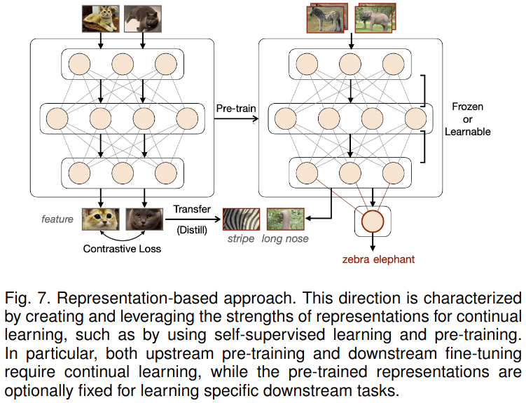
Representation-based approaches
Pretraining of a representation, followed by adaptation for each CL state, with partial or complete freezing of the feature extractor
First approaches based on supervised learning
Recently superseded by self-supervised approaches
Recently, work done on continual pretraining to integrate new pretraining data in the pretrained extractors
Notes:
Wang, Liyuan, et al. "A comprehensive survey of continual learning: Theory, method and application." arXiv preprint arXiv:2302.00487 (2023).

Slide 33
In practice
Successful methodes often combine approaches
  Regularization + replay
  Regularization + architecture + replay
  Optimization + replay
  Regularization + architecture
More details in the next course

Slide 34
Desirable properties of CL methods

Slide 35
CL desirable properties
Complexity - capacity to integrate new information with a minimal change of the model structure
Memory - ability to work with/without a memory which contains exemplars of past classes
Accuracy - incremental performance should approach that of a standard learning process
Timeliness - delay needed between the occurrence of new data and its integration in the incremental models
Plasticity-Stability - capacity to ensure a good accuracy for both past and new classes
Scalability - ability of the methods to integrate a large number of classes

Slide 36
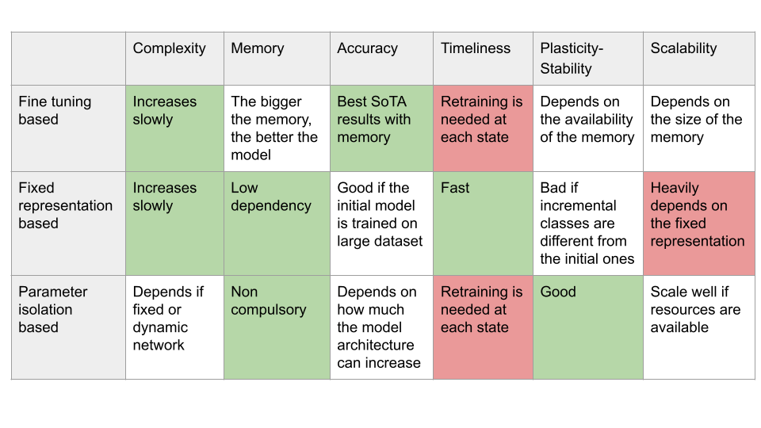
Analysis of main categories of CL methods

Slide 37
CL desiderata (1/2)
Constant memory - to avoid unbounded systems, memory should be constant w.r.t. the number of states or stream length
No task boundaries - should be required to make CL applicable to any data stream
Online learning - no offline training of large batches to enable fast acquisition of new information
Forward transfer - importance of previously acquired knowledge to aid a more efficient learning of new tasks
Backward transfer - retaining previous knowledge when ingesting new data
Notes:
De Lange, Matthias, et al. "A continual learning survey: Defying forgetting in classification tasks." IEEE transactions on pattern analysis and machine intelligence 44.7 (2021): 3366-3385.

Slide 38
CL desiderata (2/2)
Problem agnostic - tackle different visual tasks (classification, detection, segmentation etc.)
Adaptive systems - to learn from unlabeled data and enable adaptation to application data
No test time oracle - task ID labels should not be necessary during inference
Task revisiting - enhancement of previous task knowledge when the yare revisited
Graceful forgetting - selective forgetting of trivial information to achieve balance between stability and plasticity
Notes:
De Lange, Matthias, et al. "A continual learning survey: Defying forgetting in classification tasks." IEEE transactions on pattern analysis and machine intelligence 44.7 (2021): 3366-3385.

Slide 39
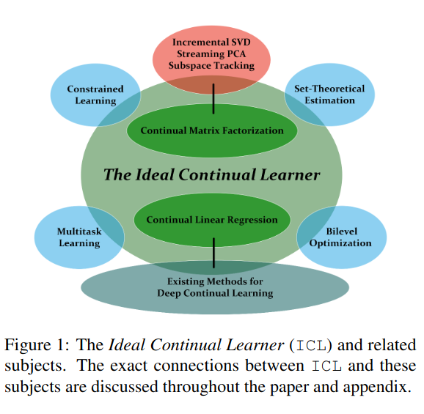

The ideal continual learner (Peng et al, 2023)
Theoretical exploration of CL
Links to neighboring domains
Focus on two examples to highlight what a ideal continual learner (ICL) is
  Sufficient - all tasks are solved optimally
  Minimal - the knowledge repres. of all tasks is stored
Notes:
Peng, Liangzu, Paris Giampouras, and René Vidal. "The ideal continual learner: An agent that never forgets." International Conference on Machine Learning. PMLR, 2023.

Slide 40
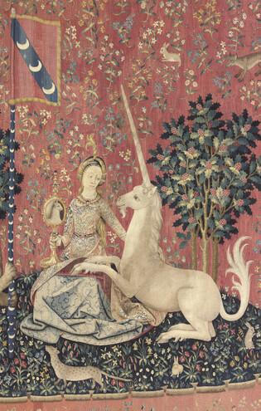
Takeaways
Many approaches were proposed to tackle CL
  Needed due to the variability of CL scenarios and assumptions
(Probably) illusory to search for a method which does best in all scenarios
Rank your priorities and focus on approaches which are adequate for top-ranked priorities

