Slide 1
Continual Learning for Image Classification
Course 1: Introduction
Adrian Popescu
adrian.popescu@cea.fr

Slide 2
Overview
Motivation
Related areas
Continual learning (CL) scenarios
Continual learning challenges
Methods for continual image classification
Focus on main components of CL methods
Good practices for evaluation
Continual learning deployment
Open issues

Slide 3

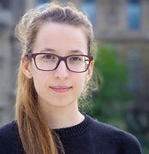
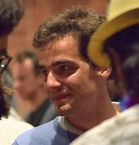

Why am I here?
Continual learning
  Interesting
  Frustrating
  Useful
I feel lucky
Alexandru Ginsca
2016 - 2017
Eden Belouadah
2018 - 2021
Grégoire Petit
2020 - 2023
Eva Feillet
2021 - 2024

Slide 4

Why are you here?
Beyond earning credits
And

Slide 5
Motivation(s)

Slide 6
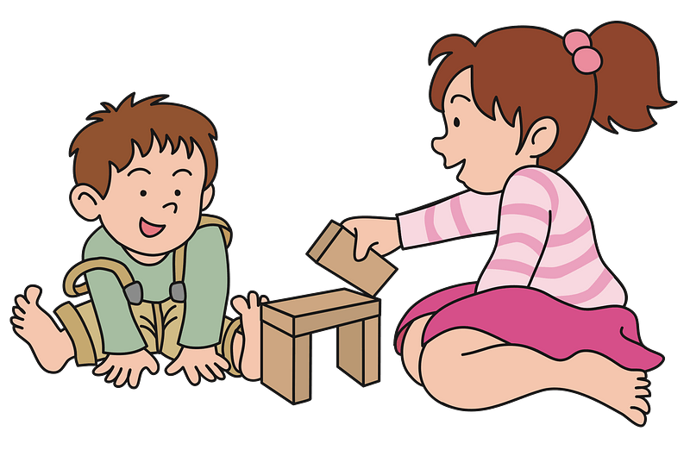
Human learning
Very slow
Collaborative process
Open-world hypothesis
Generic learning
“Training” with scarce data
Energy-efficient (0.3 kWh/day)
Knowledge is added and forgotten continuously

Slide 7
Human learning
Machine learning
Very slow
Collaborative process
Open-world hypothesis
Generic learning
“Training” with scarce data
Energy-efficient (0.3 kWh/day)
Knowledge is added and forgotten continuously
(Very) fast
Mostly centralized
Closed world assumption
(Mostly) specialized
Large training datasets
Energy-intensive (433 MWh for BLOOM language model)
One-off learning paradigm

Slide 8
Standard machine learning assumptions about data
Labeled training data are abundant
Data are always at hand
Data labels are readily available
The target domain coverage is sufficient
Data are evenly distributed in the represented space

Slide 9
Data in practice
Labeled training data are abundant
Data are always at hand
Data labels are readily available
The target domain coverage is sufficient
Data are evenly distributed in the represented space
Labeled training data are often scarce
Data are lost/removed
Labeling is a costly process, particularly if specialized
Novelty occurs: new classes or class representations
Training datasets are majoritarily imbalanced

Slide 10
Standard machine learning assumptions about machines
Storage is abundant
RAM memory is sufficient
Parametric footprint of models can be set arbitrarily
Computation capacity is sufficient during
  Training
  Inference
The data/power plugs are on

Slide 11
Machines in practice
Storage is abundant
RAM is sufficient
Parametric footprint of models can be set arbitrarily
Computation capacity is sufficient during
  Training
  Inference
The data/power plugs are on
Storage size varies a lot
RAM is often constrained
Parametric footprint should be adapted to target devices
Computation capacity is limited for
  Training and/or
  Inference
The plugs are often off

Slide 12
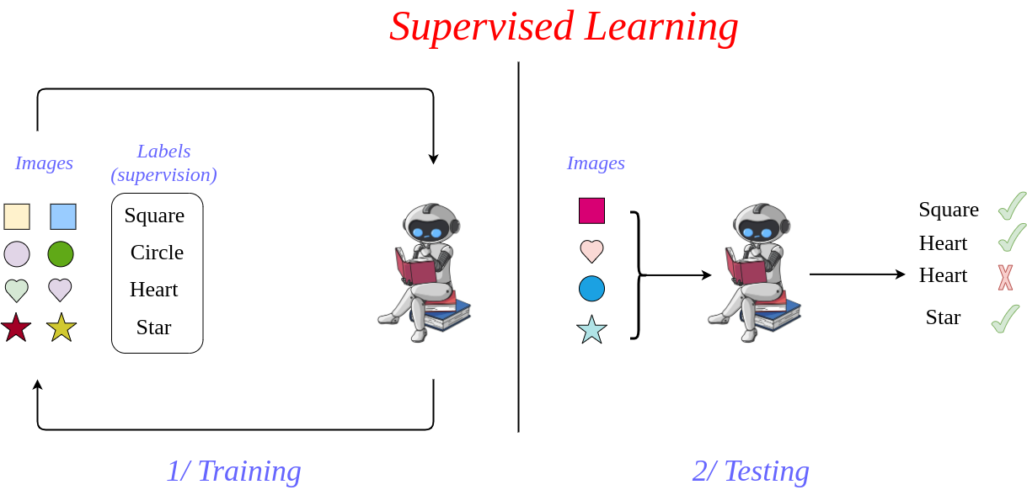
Move from standard learning

Slide 13
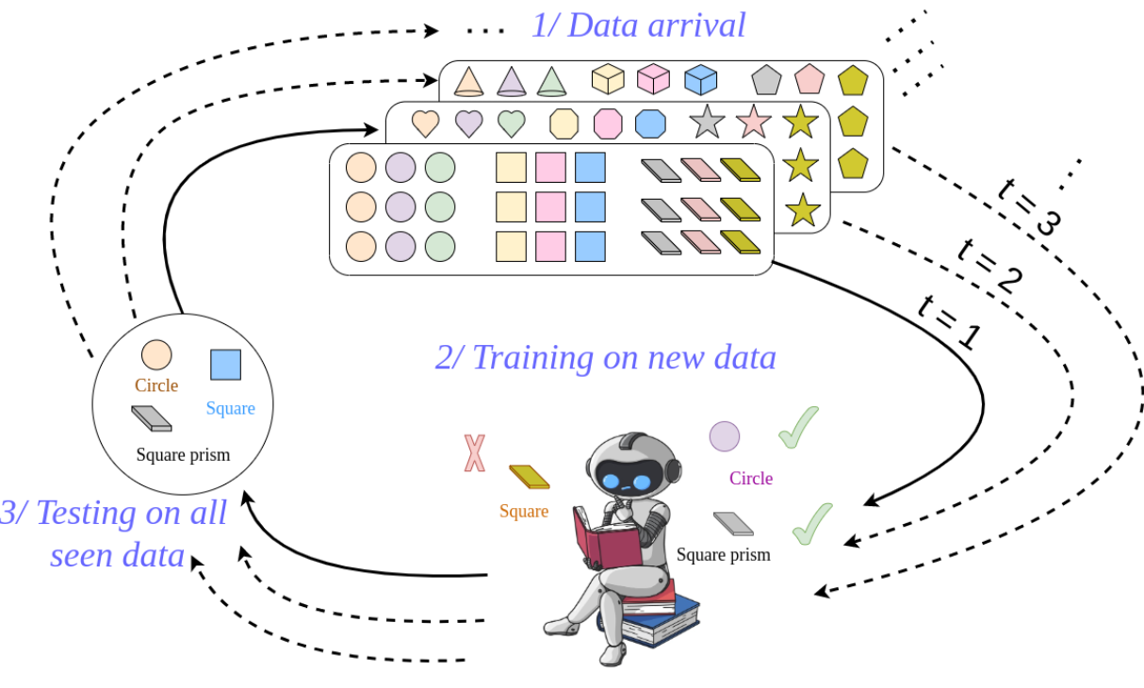
Toward continual learning (when needed)

Slide 14
A bit of history
1980s - first works on incremental learning
1990s
  catastrophic forgetting
  Unsupervised learning
2000s
  incremental SVMs
2016
  Deep continual learning
Notes:
Schlimmer, Jeffrey C., and Douglas Fisher. "A case study of incremental concept induction." Proceedings of the Fifth AAAI National Conference on Artificial Intelligence. 1986.
McCloskey, Michael, and Neal J. Cohen. "Catastrophic interference in connectionist networks: The sequential learning problem." Psychology of learning and motivation. Vol. 24. Academic Press, 1989. 109-165.
Fritzke, Bernd. "A growing neural gas network learns topologies." Advances in neural information processing systems 7 (1994).
Ruping, Stefan. "Incremental learning with support vector machines." Proceedings 2001 IEEE international conference on data mining. IEEE, 2001.
Li, Zhizhong, and Derek Hoiem. "Learning without forgetting." IEEE transactions on pattern analysis and machine intelligence 40.12 (2017): 2935-2947.

Slide 15
Continual learning requirements
Data
  Learn from streams of data whose distribution shifts over time
  Assume that access to past data is limited or impossible
  Devise methods for different stream structures
Resources
  Calibrate the storage, RAM and parametric footprint of models depending on the characteristics of the target device
  Focus on a trade-off between efficacy and efficiency

Slide 16

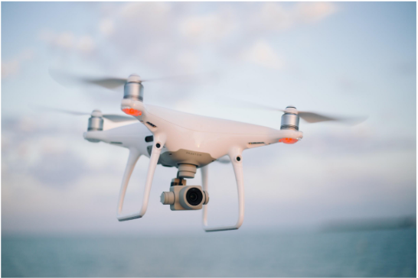

Examples of potential applications
Storage and sharing of health-related data are heavily regulated. Models should be updated without access to past data.
Events, persons, organizations which appear constantly and models need to be updated quickly
Autonomous systems have limited computation capabilities. Training and inference should be energy-efficient.

Slide 17
Related areas

Slide 18
Online learning
Common points
Differences
Focus on streams of data whose overall distribution is unknown
Training with subsets of the entire stream of data
Focus on out-of-core algorithms in online learning
Memory-related constraints are weaker

Slide 19
Transfer learning
Common points
Differences
Representations need to be transferred between subsets of data
A transferable model, pre-trained on a large training set is available
One step transfer from pre-trained model to target domain
No need to preserve performance on pre-training data

Slide 20
Few-shot learning
Common points
Differences
Labeled training data are scarce
Pre-trained models can be used to compensate for data scarcity
Few-shot learning implements a one-off training procedure
An access to all training data is assumed

Slide 21
Learning at the edge
Common points
Differences
The storage is limited
The computational capacities are constrained
The training and inference processes need to be energy-efficient
One-off training when learning at the edge
An access to all training data is assumed

Slide 22
Continual learning scenarios
Stream structure

Slide 23




Evaluation measures
Forgetting
Difference between the current performance of a task and its maximum past performance
Complementary to accuracy
Forgetting per state
Average accuracy
Aggregates accuracy over all CL states
Assumes equal weight for each state
Average forgetting
State accuracy
Average incremental accuracy

Slide 24
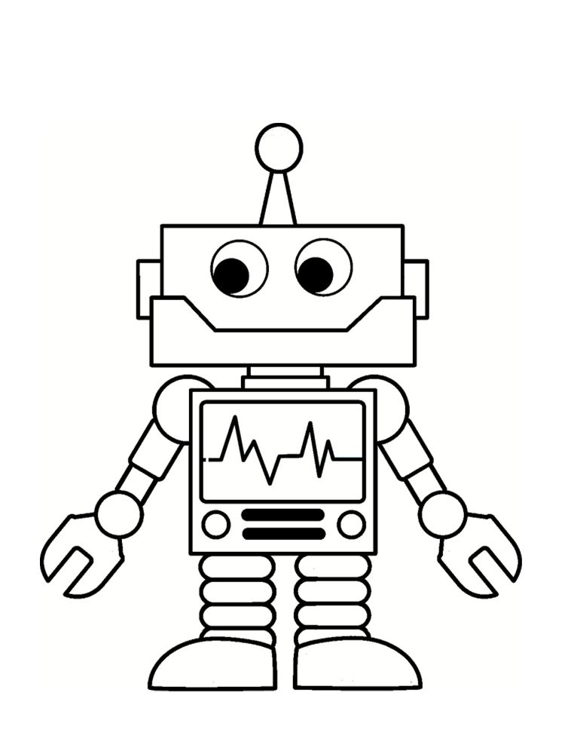
Data stream structure
Training
Inference
State 1
State 2
State 3
Task ID = 1
Task CL
?
Class CL
?
Domain CL
?
Generic CL
?
Time

Slide 25
Task-focused continual learning
Characteristics
  Data are structured semantically
  Novelty is given by new target domains
  No repetition between states
  The task ID is assumed known during inference
Challenges
  The stream structure might be constraining in practice
  Only useful if the task ID is actually available

Slide 26
Class-focused continual learning
Characteristics
  Domains are mixed across states
  Novelty is given by new classes
  No repetition between states
  No assumption about the task ID
Challenges
  The stream structure might be constraining in practice
  Any known class might occur during inference
A.k.a. Class-incremental learning (CIL)

Slide 27
Domain-based continual learning
Characteristics
  All classes are known at the beginning
  Novelty is given by new samples of known classes
  No repetition between states
  No assumption about the task ID
Challenges
  The integration of novelty is limited to known classes
  Any known class might occur during inference

Slide 28
Generic continual learning
Characteristics
  The assumptions about the stream structure are minimal
  New classes might appear during continual states
  New samples of past classes might occur
  No assumption about the task ID
Challenges
  The stream is realistic, but more difficult to learn from
  Any known class might occur during inference

Slide 29
Class distribution in streams
Evenly distributed classes across incremental states
Half of the classes in the first state, then even distribution for the rest of the CL process
Random distribution of classes between the incremental states

Slide 30
Class distribution in streams
The performance of algorithms depends of the distribution of classes
  Half-first scenario leads to stronger initial models and favors algorithms which focus on stability
Random distribution of classes is the most challenging scenario
  But also the most realistic one
Adding one class at the time is impossible for many existing algorithms
  At least two classes are needed for discriminative learning

Slide 31
Continual learning scenarios
Data availability

Slide 32
Memory availability
A representation of past data is needed to make inference about them at any times
The memory can consist of
  A deep model trained with past data
  A buffer of exemplars (samples) of the past
  A generative model which creates pseudo-samples of the past
A combination of memory types is possible, but it adds constraints for the deployment of CL methods

Slide 33
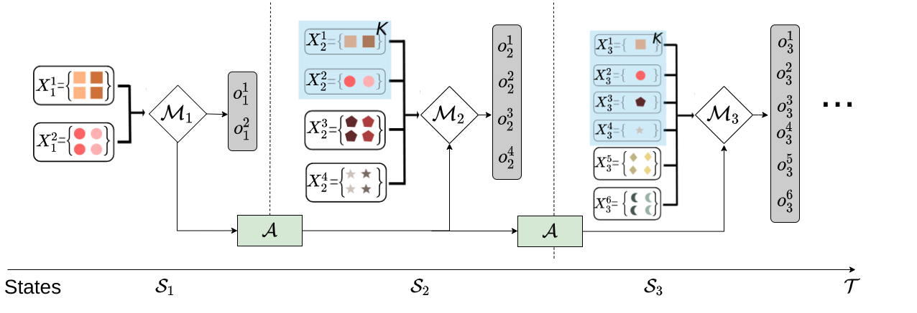
Exemplar-based continual learning
A memory buffer enables rehearsal
CL = instance of imbalanced learning
Model updates are based on the previous model, the new data and the exemplars from the memory bufferI
Imbalance increases over time
  Possible to store a fixed number of samples per class
  But the size of the memory increases over time
Notes:
Robins, Anthony. "Catastrophic forgetting, rehearsal and pseudorehearsal." Connection Science 7.2 (1995): 123-146.

Slide 34
Exemplar-based continual learning - practical example
Backbone deep model: ResNet-18
  ~11 M parameters -> 45 MB storage
  ~90 MB storage at peak - need to store the previous model
Storage of past exemplars: 100 kB per image
  Fixed memory of 10,000 images -> 1 GB of storage
  Fixed number of samples per class: 20
    100 classes -> 200 MB of storage
    1000 classes -> 2 GB of storage

Slide 35
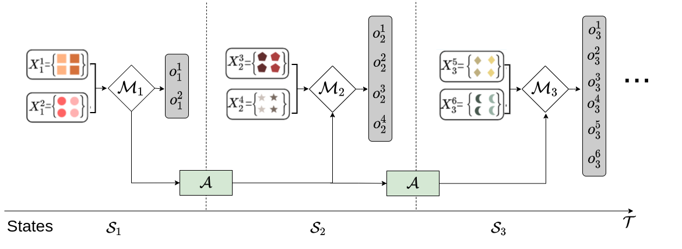
Exemplar-free continual learning
No memory buffer is allowed
More challenging form of CL
Model updates are based only on the previous model and the new data
Catastrophic forgetting occurs if no countermeasures are taken
A balance between stability and plasticity of models is needed

Slide 36
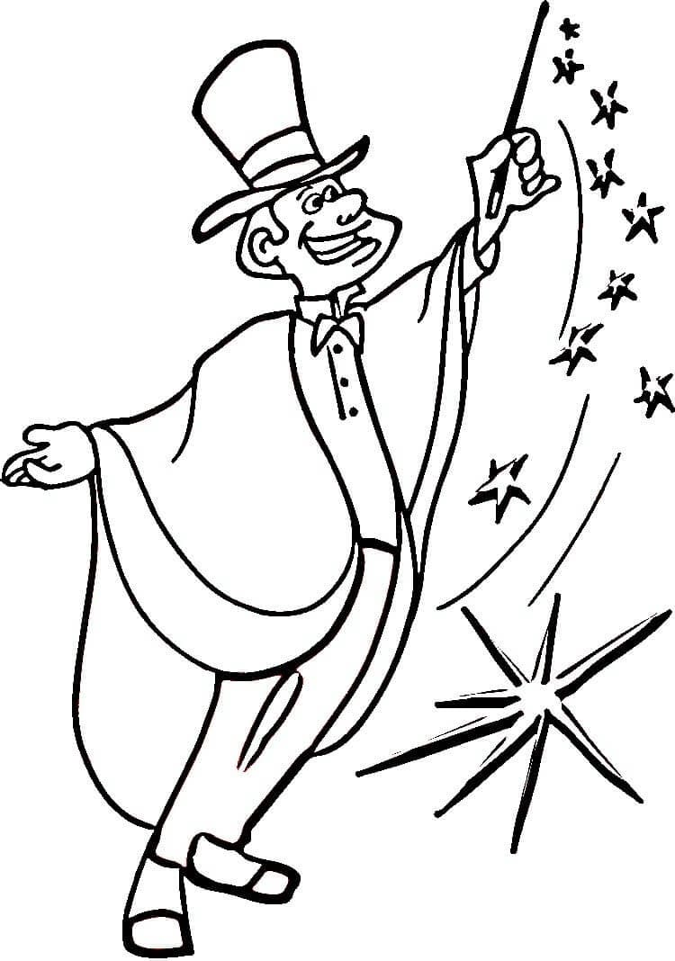
Training data availability
Most existing CL algorithms are designed for fully-supervised learning
A wide majority of experiments are run with a large number of samples per class
The stream of data is supposed to be readily labeled at the start of the CL process
Strong assumptions in practice

Slide 37
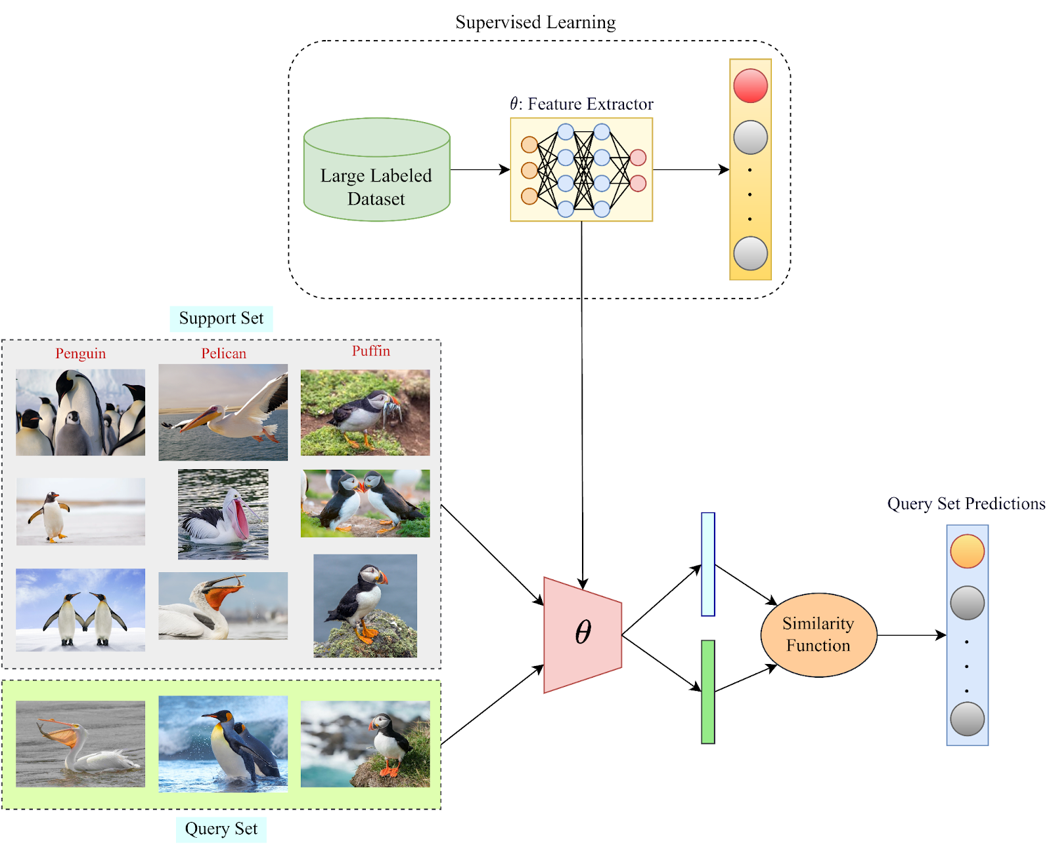
Training data availability - few-shot learning
Useful when there are only a handful of images per class in the target domain
The representation of the domain is necessarily weak
A pretrained model is reused as feature extractor to compensate for the lack of domain data
Notes:
https://blog.paperspace.com/few-shot-learning/

Slide 38
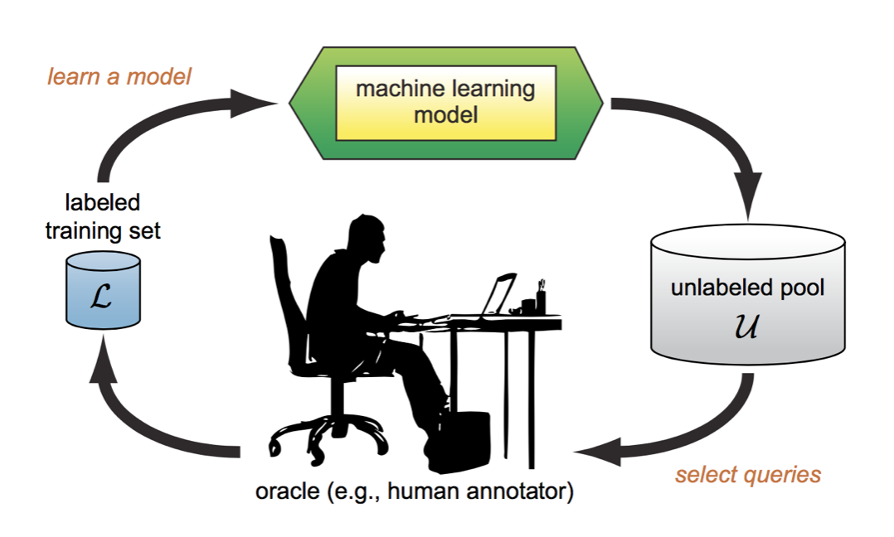
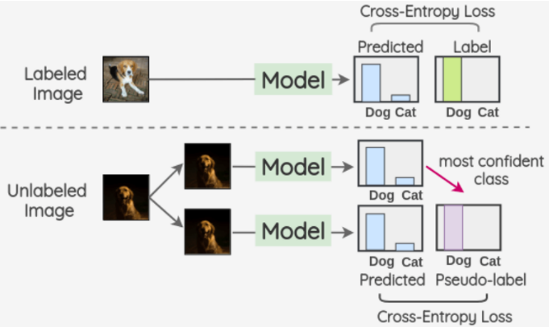
Training data availability - active + semi-supervised learning
Useful when there are lots of data in the target domain, but only a part of them can be annotated
Active learning to manually annotate a subset of the dataset
Semi-supervised learning with pseudo-labeling of the unlabeled data
Notes:
https://blog.paperspace.com/few-shot-learning/

Slide 39
Continual learning scenarios
Deep backbone models

Slide 40
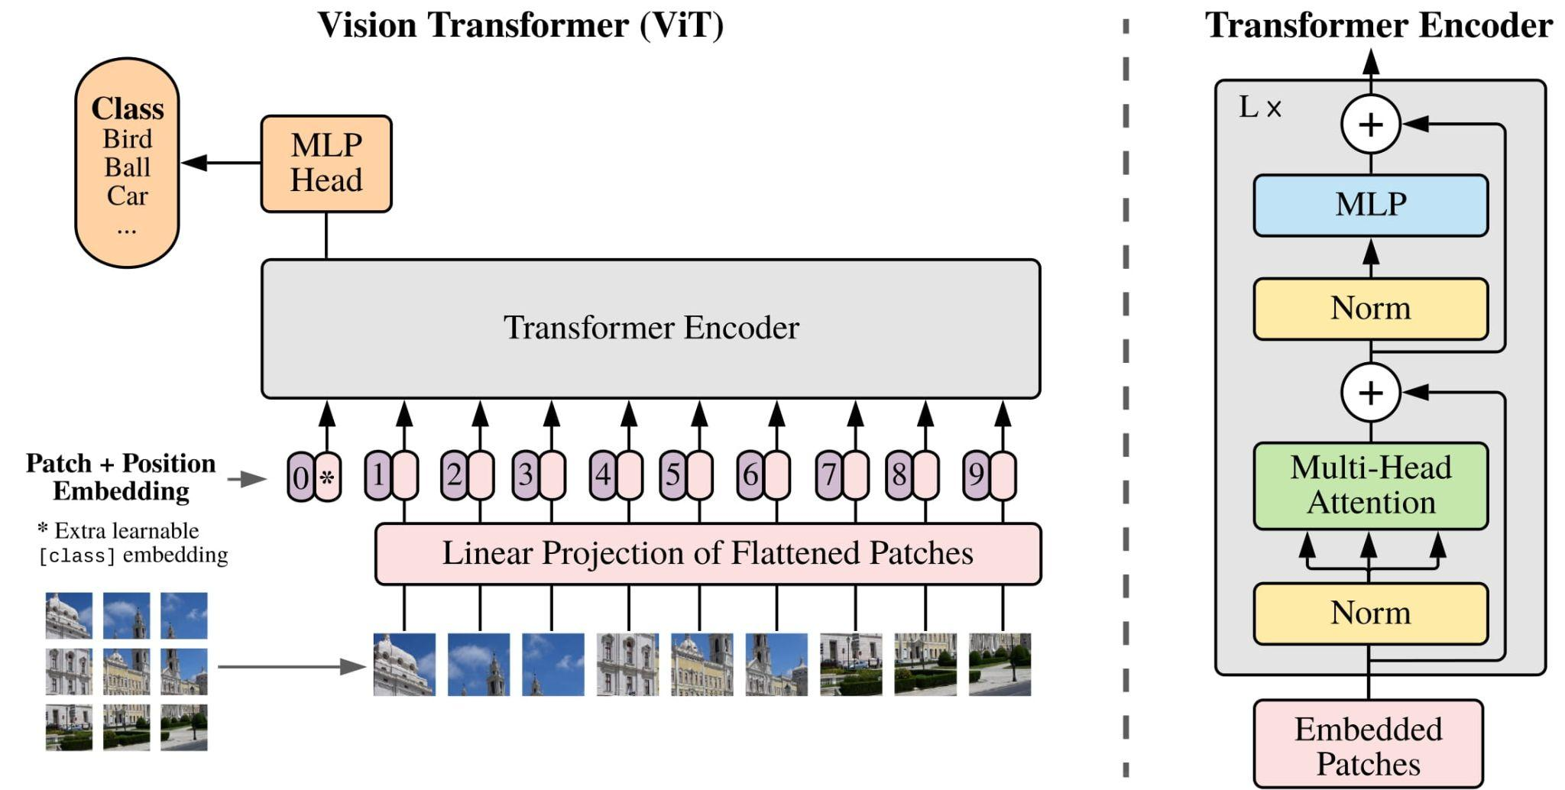
Backbone architectures
CL algorithms usually deployed with small- to medium-sized architectures
  Simulate complexity constraints
  Run experiments faster
CNNs were the most frequently used backbones until recently
  ~11 M parameters for ResNet-18
Recent move toward transformers
  ViT-B/16 Small with ~22M parameters
Notes:
Rebuffi, Sylvestre-Alvise, et al. "icarl: Incremental classifier and representation learning." Proceedings of the IEEE conference on Computer Vision and Pattern Recognition. 2017.
Dosovitskiy, Alexey, et al. "An image is worth 16x16 words: Transformers for image recognition at scale." arXiv preprint arXiv:2010.11929 (2020).

Slide 41
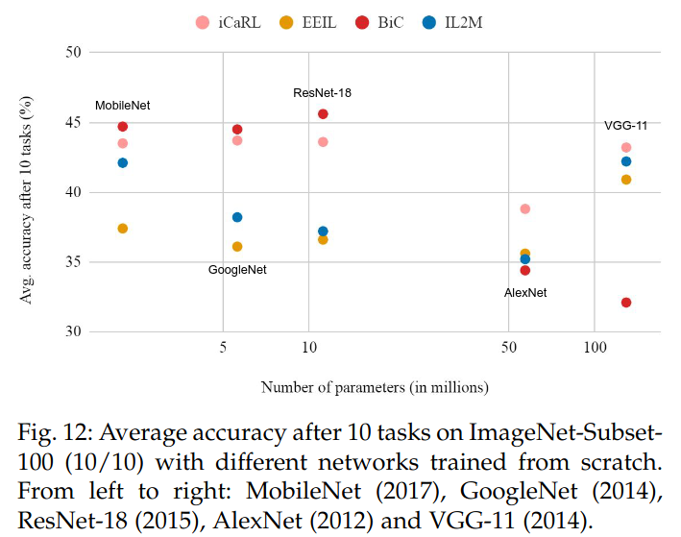
Impact of different neural architectures
The neural architecture has an important impact on the relative performance of the methods
The number of parameters in different architectures is not a good predictor of CL performance

Slide 42
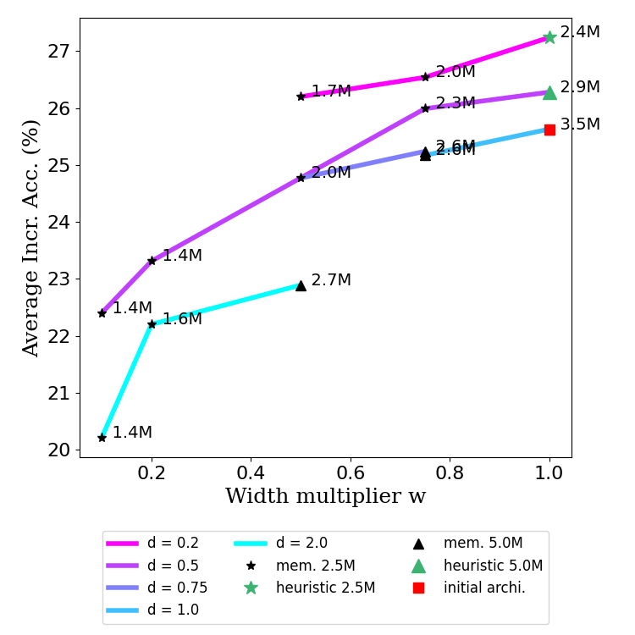
Impact of scaling a MobileNet architecture
Scaling is done by using depth and width multiplication factors to get similar parametric footprints
Results confirm that wider neural networks forget less catastrophically (Mirzadeh et al, 2022)
Notes:
Mirzadeh, Seyed Iman, et al. "Wide neural networks forget less catastrophically." International Conference on Machine Learning. PMLR, 2022.

Slide 43
Fixed-size backbone algorithms
The parametric footprint is constant throughout the continual learning process
Except for the classification layer which needs to grow
Approach which is adapted under computational constraints
Usable for large scale CL (in theory)
Challenging to keep performance close to that of standard deep learning
State 1
State 2
Backbone
model
Backbone
model
Classifier
1
Classifier
1+2

Slide 44
Growing backbone algorithms
The parametric footprint is increases throughout the continual learning process
A set of parameters is added in each CL state
Approach which is less adapted under computational constraints
Less usable for large scale CL
Easier to keep performance close to that of standard deep learning
State 1
State 2
Backbone
model
Backbone
model
Classifier
1
Classifier
1+2

Slide 45
Pretrained backbone models
The use of external large-scale data produces strong and transferable representations
  Supervised pretraining - needs labeled datasets, i.e. ImageNet
  Weakly-supervised pretraining - needs partially labeled datasets
  Self-supervised pretraining - works with unlabeled datasets
    More scalable and more transferable deep representations
Heated debate in CL regarding the use of pretrained models
Pretraining is more accepted with the advent of foundation models
  Opportunity or existential threat for CL?

Slide 46
Wrapping-up
Continual learning scenarios are defined by a combination of
  Data stream structure
  Class distribution in streams
  Memory availability
  Training dataset size
  Type of architecture
  Size of the backbone model
  Availability of a pretraining model
Stream
Data
Backbone

Slide 47
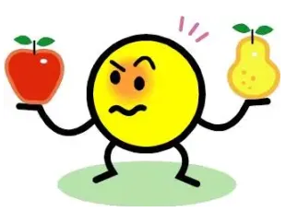
Wrapping up
Wealth of possible scenarios by combining assumptions made about the scenario
Good news
  Modeling and analysis of the task is interesting
  Lots of publishing opportunities
Bad news
  Lots of room for unfair comparisons

Slide 48
Next
Challenges in continual learning
  Catastrophic forgetting
  Stability-plasticity balance
Taxonomy of CL methods
Desirable properties of CL methods

